Slide 1
Syllabus
Unit II - Process Description and Control
Process: Concept of a Process, Process States, Process Description, Process Control (Process creation, Waiting for the process/processes, Loading programs into processes and Process Termination), Execution of the Operating System. Threads: Processes and Threads, Concept of Multithreading, Types of Threads, Thread programming Using Pthreads. Scheduling: Types of Scheduling, Scheduling Algorithms, and Thread Scheduling

Slide 2
OS Management of Application Execution
Resources are made available to multiple applications
The processor is switched among multiple applications so all will appear to be progressing
The processor and I/O devices can be used efficiently
Notes:
Now that we have the concepts of applications, system software, and resources,
we are in a position to discuss how the OS can, in an orderly fashion, manage the
execution of applications so that
• Resources are made available to multiple applications.
• The physical processor is switched among multiple applications so all will
appear to be progressing.
• The processor and I/O devices can be used efficiently.
The approach taken by all modern operating systems is to rely on a model in
which the execution of an application corresponds to the existence of one or more
processes.

Slide 3
What is a Process?
A process is basically a program under execution.
The execution of a process must progress in a sequential fashion.
we write our computer programs in a text file and when we execute this program, it becomes a process which performs all the tasks mentioned in the program.
A process utilizes CPU time and I/o resources.
A process can be divided into four sections ─ stack, heap, text and data.

Slide 4
Process Elements
Two essential elements of a process are:
When the processor begins to execute the program code, we refer to this executing entity as a process
Program code
which may be shared with other processes that are executing the same program
A set of data associated with that code
Notes:
Recall from Chapter 2 that we suggested several definitions of the term process ,
including
• A program in execution
• An instance of a program running on a computer
• The entity that can be assigned to and executed on a processor
• A unit of activity characterized by the execution of a sequence of instructions,
a current state, and an associated set of system resources
We can also think of a process as an entity that consists of a number of elements.
Two essential elements of a process are program code (which may be shared with
other processes that are executing the same program) and a set of data associated
with that code. Let us suppose that the processor begins to execute this program
code, and we refer to this executing entity as a process.

Slide 5
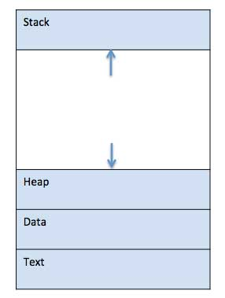
What is a Process?
Stack
The process Stack contains temporary data like method/function parameters, return address and local variables.
Heap
This is dynamically allocated memory to a process during its run time.
Data
This section contains the global and static variables.
Text
This includes the current activity represented by the value of Program Counter and the contents of the processor's registers.

Slide 6
Process Elements
While the program is executing, the process can be uniquely characterized by a number of elements, including:
identifier
state
priority
program counter
memory pointers
context data
I/O status information
accounting information
Notes:
At any given point in time,
while the program is executing , this process can be uniquely characterized by a
number of elements, including the following:
• Identifier: A unique identifier associated with this process, to distinguish it
from all other processes.
• State: If the process is currently executing, it is in the running state.
• Priority: Priority level relative to other processes.
• Program counter: The address of the next instruction in the program to be
executed.
• Memory pointers: Includes pointers to the program code and data associated
with this process, plus any memory blocks shared with other processes.
• Context data: These are data that are present in registers in the processor
while the process is executing.
• I/O status information: Includes outstanding I/O requests, I/O devices (e.g.,
disk drives) assigned to this process, a list of files in use by the process, and
so on.
• Accounting information: May include the amount of processor time and clock
time used, time limits, account numbers, and so on.

Slide 7
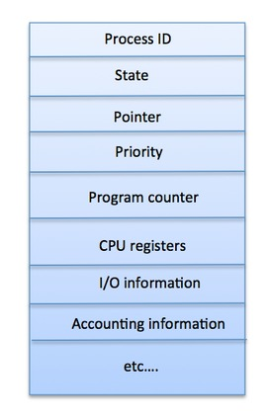
Process Control Block
Contains the process elements
It is possible to interrupt a running process and later resume execution as if the interruption had not occurred
Created and managed by the operating system
Key tool that allows support for multiple processes
Notes:
The information in the preceding list is stored in a data structure, typically
called a process control block ( Figure 3.1 ), that is created and managed by the OS.
The significant point about the process control block is that it contains sufficient
information so that it is possible to interrupt a running process and later resume
execution as if the interruption had not occurred. The process control block is
the key tool that enables the OS to support multiple processes and to provide for
multiprocessing. When a process is interrupted, the current values of the program
counter and the processor registers (context data) are saved in the appropriate fields
of the corresponding process control block, and the state of the process is changed
to some other value, such as blocked or ready . The OS is
now free to put some other process in the running state. The program counter and
context data for this process are loaded into the processor registers and this process
now begins to execute.
Thus, we can say that a process consists of program code and associated data
plus a process control block. For a single-processor computer, at any given time, at
most one process is executing and that process is in the running state.

Slide 8
Process States
Trace
the behavior of an individual process by listing the sequence of instructions that execute for that process
the behavior of the processor can be characterized by showing how the traces of the various processes are interleaved
Dispatcher
small program that switches the processor from one process to another
Notes:
As just discussed, for a program to be executed, a process, or task, is created for
that program. From the processor’s point of view, it executes instructions from its
repertoire in some sequence dictated by the changing values in the program counter
register. Over time, the program counter may refer to code in different programs
that are part of different processes. From the point of view of an individual program,
its execution involves a sequence of instructions within that program.
We can characterize the behavior of an individual process by listing the
sequence of instructions that execute for that process. Such a listing is referred to
as a trace of the process. We can characterize behavior of the processor by showing
how the traces of the various processes are interleaved.

Slide 9
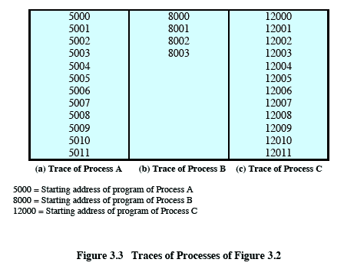
Traces of Processes of Figure 3.2
Each process runs to completion
Figure 3.3
Notes:
Figure 3.3 shows the traces of each
of the processes during the early part of their execution. The first 12 instructions
executed in processes A and C are shown. Process B executes four instructions,
and we assume that the fourth instruction invokes an I/O operation for which the
process must wait.

Slide 10
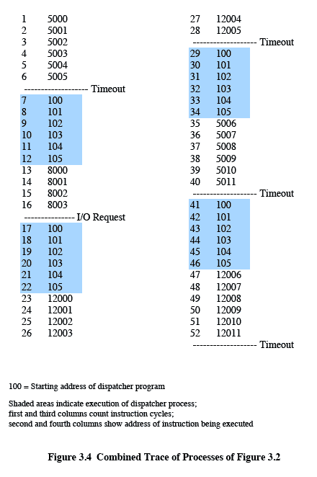
Combined Trace of Processes of Figure 3.2
Notes:
Now let us view these traces from the processor’s point of view. Figure 3.4
shows the interleaved traces resulting from the first 52 instruction cycles (for convenience,
the instruction cycles are numbered). In this figure, the shaded areas
represent code executed by the dispatcher. The same sequence of instructions is
executed by the dispatcher in each instance because the same functionality of the
dispatcher is being executed. We assume that the OS only allows a process to continue
execution for a maximum of six instruction cycles, after which it is interrupted;
this prevents any single process from monopolizing processor time. As Figure 3.4
shows, the first six instructions of process A are executed, followed by a time-out
and the execution of some code in the dispatcher, which executes six instructions
before turning control to process B. 2 After four instructions are executed, process
B requests an I/O action for which it must wait. Therefore, the processor stops
executing process B and moves on, via the dispatcher, to process C. After a timeout,
the processor moves back to process A. When this process times out, process
B is still waiting for the I/O operation to complete, so the dispatcher moves on to
process C again.

Slide 11
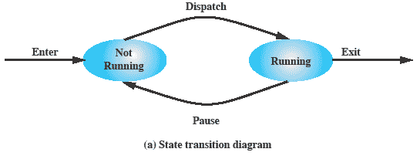
Two-State Process Model
A process may be in one of the two states:
running
not-running
Notes:
The operating system’s principal responsibility is controlling the execution of
processes; this includes determining the interleaving pattern for execution and allocating
resources to processes. The first step in designing an OS to control processes
is to describe the behavior that we would like the processes to exhibit.
We can construct the simplest possible model by observing that, at any time, a
process is either being executed by a processor or not. In this model, a process may
be in one of two states: Running or Not Running, as shown in Figure 3.5a . When
the OS creates a new process, it creates a process control block for the process and
enters that process into the system in the Not Running state. The process exists,
is known to the OS, and is waiting for an opportunity to execute. From time to
time, the currently running process will be interrupted and the dispatcher portion
of the OS will select some other process to run. The former process moves from the
Running state to the Not Running state, and one of the other processes moves to
the Running state.

Slide 12
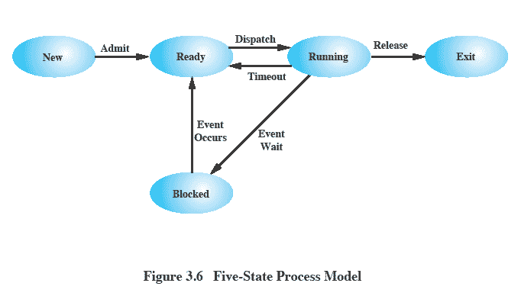
Five-State Process Model
Notes:
If all processes were always ready to execute, then the queuing discipline suggested
by Figure 3.5b would be effective. The queue is a first-in-first-out list and the processor
operates in round-robin fashion on the available processes (each process in
the queue is given a certain amount of time, in turn, to execute and then returned to
the queue, unless blocked). However, even with the simple example that we have
described, this implementation is inadequate: Some processes in the Not Running
state are ready to execute, while others are blocked, waiting for an I/O operation
to complete. Thus, using a single queue, the dispatcher could not just select the
process at the oldest end of the queue. Rather, the dispatcher would have to scan
the list looking for the process that is not blocked and that has been in the queue
the longest.
A more natural way to handle this situation is to split the Not Running state
into two states: Ready and Blocked. This is shown in Figure 3.6 .
The five states in this
new diagram are:
• Running: The process that is currently being executed. For this chapter, we
will assume a computer with a single processor, so at most one process at a
time can be in this state.
• Ready: A process that is prepared to execute when given the opportunity.
• Blocked/Waiting: 4 A process that cannot execute until some event occurs,
such as the completion of an I/O operation.
• New: A process that has just been created but has not yet been admitted to the
pool of executable processes by the OS. Typically, a new process has not yet
been loaded into main memory, although its process control block has been
created.
• Exit: A process that has been released from the pool of executable processes
by the OS, either because it halted or because it aborted for some reason.
Figure 3.6 indicates the types of events that lead to each state transition for a
process; the possible transitions are as follows:
• Null : New: A new process is created to execute a program. This event occurs
for any of the reasons listed in Table 3.1 .
• New : Ready: The OS will move a process from the New state to the Ready
state when it is prepared to take on an additional process. Most systems set
some limit based on the number of existing processes or the amount of virtual
memory committed to existing processes. This limit assures that there are not
so many active processes as to degrade performance.
• Ready : Running: When it is time to select a process to run, the OS chooses
one of the processes in the Ready state. This is the job of the scheduler or
dispatcher. Scheduling is explored in Part Four.
• Running : Exit: The currently running process is terminated by the OS if the
process indicates that it has completed, or if it aborts. See Table 3.2 .
• Running : Ready: The most common reason for this transition is that the
running process has reached the maximum allowable time for uninterrupted
execution; virtually all multiprogramming operating systems impose this type
of time discipline. There are several other alternative causes for this transition,
which are not implemented in all operating systems. Of particular importance
is the case in which the OS assigns different levels of priority to different
processes.
Running : Blocked: A process is put in the Blocked state if it requests something
for which it must wait. A request to the OS is usually in the form of a
system service call; that is, a call from the running program to a procedure
that is part of the operating system code. For example, a process may request
a service from the OS that the OS is not prepared to perform immediately. It
can request a resource, such as a file or a shared section of virtual memory,
that is not immediately available. Or the process may initiate an action, such
as an I/O operation, that must be completed before the process can continue.
When processes communicate with each other, a process may be blocked
when it is waiting for another process to provide data or waiting for a message
from another process.
• Blocked : Ready: A process in the Blocked state is moved to the Ready state
when the event for which it has been waiting occurs.
• Ready : Exit: For clarity, this transition is not shown on the state diagram. In
some systems, a parent may terminate a child’ process at any time. Also, if a parent
terminates, all child processes associated with that parent may be terminated.
• Blocked : Exit: The comments under the preceding item apply.

Slide 13
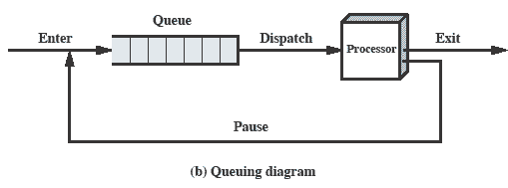
Queuing Diagram
Notes:
From this simple model, we can already begin to appreciate some of the design
elements of the OS. Each process must be represented in some way so that the OS
can keep track of it. That is, there must be some information relating to each process,
including current state and location in memory; this is the process control block.
Processes that are not running must be kept in some sort of queue, waiting their turn
to execute. Figure 3.5b suggests a structure. There is a single queue in which each
entry is a pointer to the process control block of a particular process. Alternatively,
the queue may consist of a linked list of data blocks, in which each block represents
one process; we will explore this latter implementation subsequently.
We can describe the behavior of the dispatcher in terms of this queuing
diagram. A process that is interrupted is transferred to the queue of waiting processes.
Alternatively, if the process has completed or aborted, it is discarded (exits
the system). In either case, the dispatcher takes another process from the queue to
execute.

Slide 14
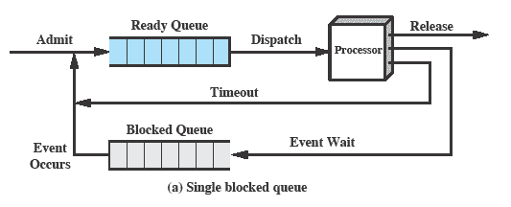
Using Two Queues
Notes:
Figure 3.8a suggests the way in which a queuing discipline
might be implemented with two queues: a Ready queue and a Blocked queue. As
each process is admitted to the system, it is placed in the Ready queue. When it is
time for the OS to choose another process to run, it selects one from the Ready
queue. In the absence of any priority scheme, this can be a simple first-in-first-out
queue. When a running process is removed from execution, it is either terminated
or placed in the Ready or Blocked queue, depending on the circumstances. Finally,
when an event occurs, any process in the Blocked queue that has been waiting on
that event only is moved to the Ready queue.

Slide 15
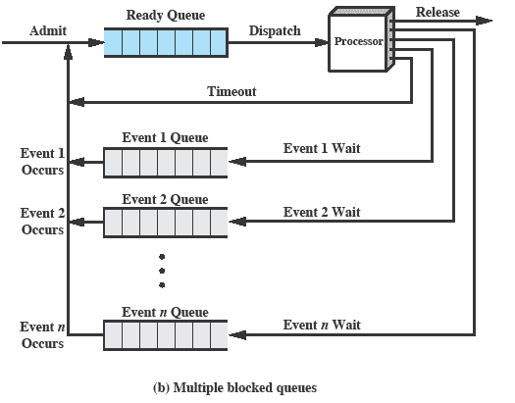
Multiple Blocked Queues
Notes:
This latter arrangement means that, when an event occurs, the OS must scan
the entire blocked queue, searching for those processes waiting on that event. In a
large OS, there could be hundreds or even thousands of processes in that queue.
Therefore, it would be more efficient to have a number of queues, one for each
event. Then, when the event occurs, the entire list of processes in the appropriate
queue can be moved to the Ready state ( Figure 3.8b ).
One final refinement: If the dispatching of processes is dictated by a priority
scheme, then it would be convenient to have a number of Ready queues, one for
each priority level. The OS could then readily determine which is the highest-priority
ready process that has been waiting the longest.

Slide 16
Process Creation
Process spawning
when the OS creates a process at the explicit request of another process
Parent process
is the original, creating, process
Child process
is the new process
Notes:
As another example,
a server process (e.g., print server, file server) may generate a new process for each
request that it handles. When the OS creates a process at the explicit request of
another process, the action is referred to as process spawning .
When one process spawns another, the former is referred to as the parent
process , and the spawned process is referred to as the child process . Typically, the
“related” processes need to communicate and cooperate with each other. Achieving
this cooperation is a difficult task for the programmer; this topic is discussed in
Chapter 5 .

Slide 17
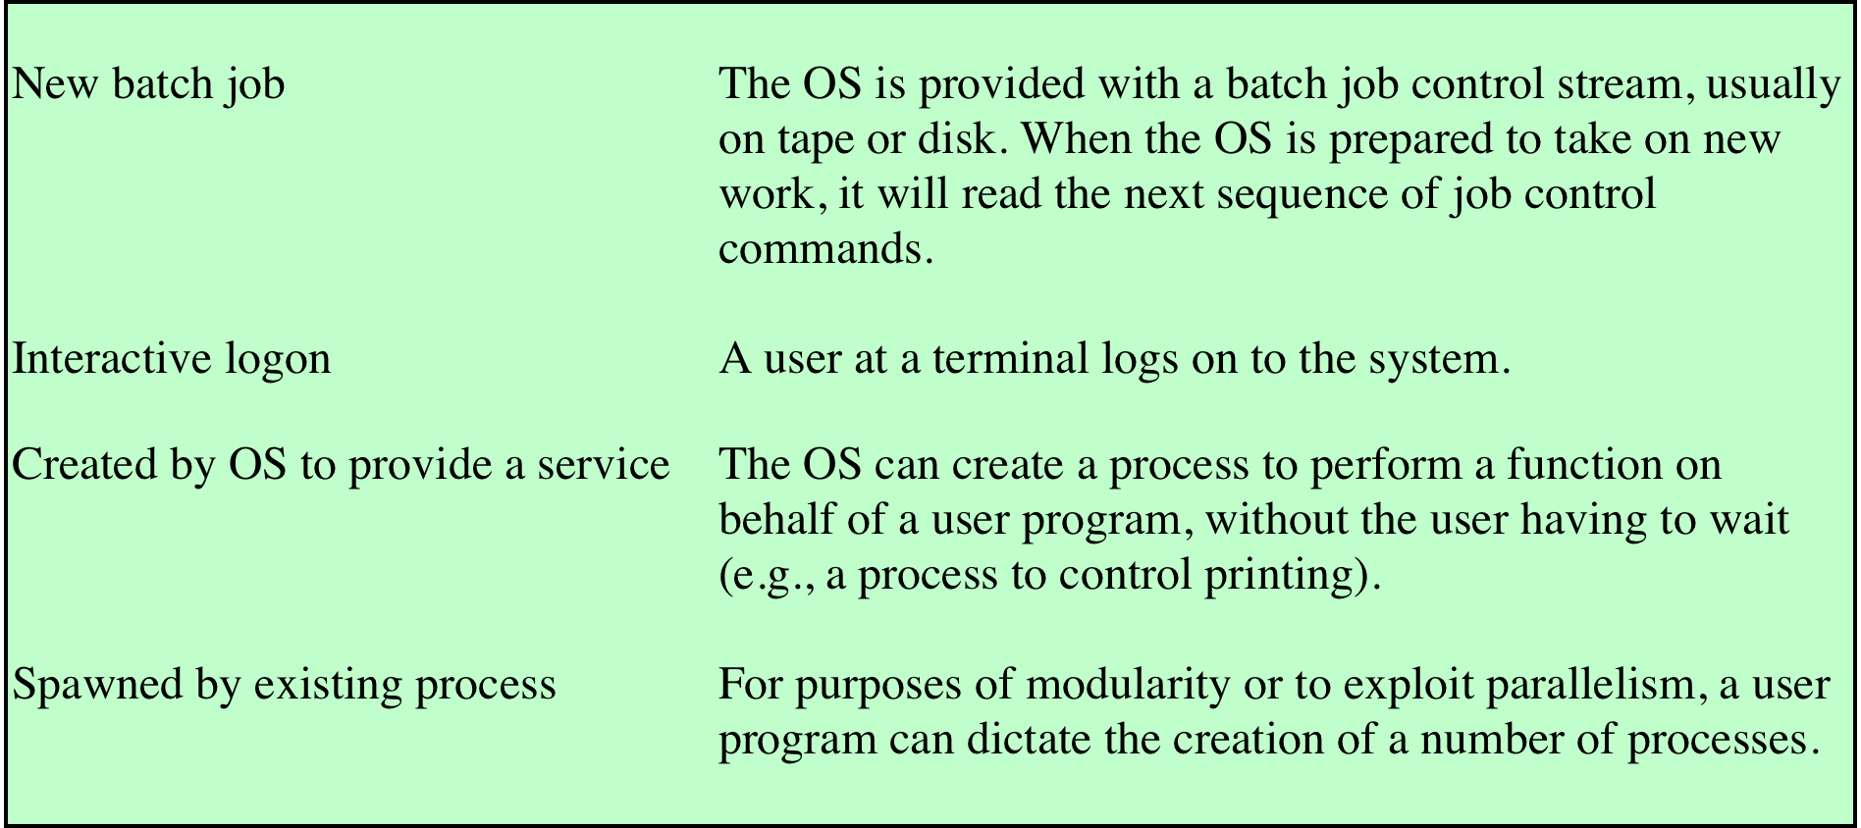
Table 3.1 Reasons for Process Creation
Notes:
When a new process is to be added to those currently being
managed, the OS builds the data structures that are used to manage the process
and allocates address space in main memory to the process. We describe these data
structures in Section 3.3 . These actions constitute the creation of a new process.
Four common events lead to the creation of a process, as indicated in Table 3.1 .
In a batch environment, a process is created in response to the submission of a job.
In an interactive environment, a process is created when a new user attempts to
log on. In both cases, the OS is responsible for the creation of the new process.
An OS may also create a process on behalf of an application. For example, if a
user requests that a file be printed, the OS can create a process that will manage
the printing. The requesting process can thus proceed independently of the time
required to complete the printing task.
Traditionally, the OS created all processes in a way that was transparent to the
user or application program, and this is still commonly found with many contemporary
operating systems. However, it can be useful to allow one process to cause
the creation of another. For example, an application process may generate another
process to receive data that the application is generating and to organize those data
into a form suitable for later analysis. The new process runs in parallel to the original
process and is activated from time to time when new data are available. This
arrangement can be very useful in structuring the application.

Slide 18
Process Creation
Once the OS decides to create a new process it:
assigns a unique process identifier to the new process
allocates space for the process
initializes the process control block
sets the appropriate linkages
creates or expands other data structures
Notes:
Once the OS decides, for whatever reason ( Table 3.1 ), to create a new process,
it can proceed as follows:
1. Assign a unique process identifier to the new process. At this time, a new entry
is added to the primary process table, which contains one entry per process.
2. Allocate space for the process. This includes all elements of the process image.
Thus, the OS must know how much space is needed for the private user address
space (programs and data) and the user stack. These values can be assigned by
default based on the type of process, or they can be set based on user request
at job creation time. If a process is spawned by another process, the parent
process can pass the needed values to the OS as part of the process-creation
request. If any existing address space is to be shared by this new process, the
appropriate linkages must be set up. Finally, space for a process control block
must be allocated.
3. Initialize the process control block. The process identification portion contains
the ID of this process plus other appropriate IDs, such as that of the parent
process. The processor state information portion will typically be initialized
with most entries zero, except for the program counter (set to the program
entry point) and system stack pointers (set to define the process stack boundaries).
The process control information portion is initialized based on standard
default values plus attributes that have been requested for this process. For
example, the process state would typically be initialized to Ready or Ready/
Suspend. The priority may be set by default to the lowest priority unless an
explicit request is made for a higher priority. Initially, the process may own
no resources (I/O devices, files) unless there is an explicit request for these or
unless they are inherited from the parent.
4. Set the appropriate linkages. For example, if the OS maintains each scheduling
queue as a linked list, then the new process must be put in the Ready or
Ready/Suspend list.
5. Create or expand other data structures. For example, the OS may maintain
an accounting file on each process to be used subsequently for billing and/or
performance assessment purposes.

Slide 19
Process Creation
When a new process is created, the operating system assigns a unique Process Identifier (PID) to it and inserts a new entry in the process table.
The required memory space for all the elements of the process such as program, data, and stack is allocated including space for its PCB.
various values in PCB are initialized such as, The process identification part is filled with PID assigned to it in step (1) and also its parent’s PID.
The process state information would be set to ‘New’.
Priority would be lowest by default, but the user can specify any priority during creation.
Then the operating system will link this process to the scheduling queue and the process state would be changed from ‘New’ to ‘Ready’. Now the process is competing for the CPU.
Additionally, the operating system will create some other data structures such as log files or accounting files to keep track of processes activity.

Slide 20
Process Creation
1
Allocate a slot in the process table for the new process
2
Assign a unique process ID to the child process
3
Make a copy of the process image of the parent, with the exception of any shared memory
4
5
6
Increments counters for any files owned by the parent, to reflect that an additional process now also owns those files
Assigns the child process to the Ready to Run state
Returns the ID number of the child to the parent process, and a 0 value to the child process
Process creation is by means of the kernel system call, fork( )
This causes the OS, in Kernel Mode, to:
Notes:
Process creation in UNIX is made by means of the kernel system call, fork( ). When
a process issues a fork request, the OS performs the following functions [BACH86]:
1. It allocates a slot in the process table for the new process.
2. It assigns a unique process ID to the child process.
3. It makes a copy of the process image of the parent, with the exception of any
shared memory.
4. It increments counters for any files owned by the parent, to reflect that an
additional process now also owns those files.
5. It assigns the child process to the Ready to Run state.
6. It returns the ID number of the child to the parent process, and a 0 value to
the child process.

Slide 21
After Creation
After creating the process the Kernel can do one of the following, as part of the dispatcher routine:
stay in the parent process
transfer control to the child process
transfer control to another process
Notes:
When the kernel has completed these functions it can do one of the following, as part of
the dispatcher routine:
• Stay in the parent process. Control returns to user mode at the point of the fork call of the parent.
• Transfer control to the child process. The child process begins executing at the same point in the code as the parent, namely at the return from the fork call.
• Transfer control to another process. Both parent and child are left in the Ready to Run state.

Slide 22
Fork() System Call
The fork () system calls creates new process.
When a process uses the fork() system call, it creates a replicate of itself.
The parent process is the existing process, and the child process is the new process.
When creating the child process, the parent states like open files, address space, and variables are copied to the child process.
The child and parent processes are located in separate physical address spaces. As a result, the modification in the parent process doesn't appear in the child process.

Slide 23
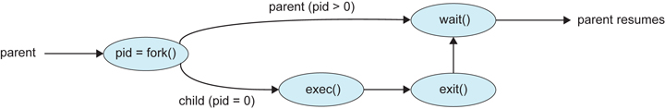
Fork() System Call

Slide 24
Exec() System Call
The exec() system call is used to make the new processes.
When the exec() function is used, the currently running process is terminated and replaced with the newly formed process.
In other words, only the new process persists after calling exec().
The parent process is shut down.
This system call also substitutes the parent process's text segment, address space, and data segment with the child process.

Slide 25
Exec() System Call
Features | Fork() | Exec()
Definition | It is a command that allows a process to copy itself. | It is a command that makes a new process by replacing the existing process.
Address Space | The parent and child processes are in separate address spaces in the fork(). | The child address space replaces the parent address space in the exec().
Parent Process | There is a child process and a parent process after calling the fork() function. | There is only a child process after calling the exec().
Result | The fork() makes a child's process equal to the parent's process. | The exec() makes a child process and replaces it with the parent process.

Slide 26
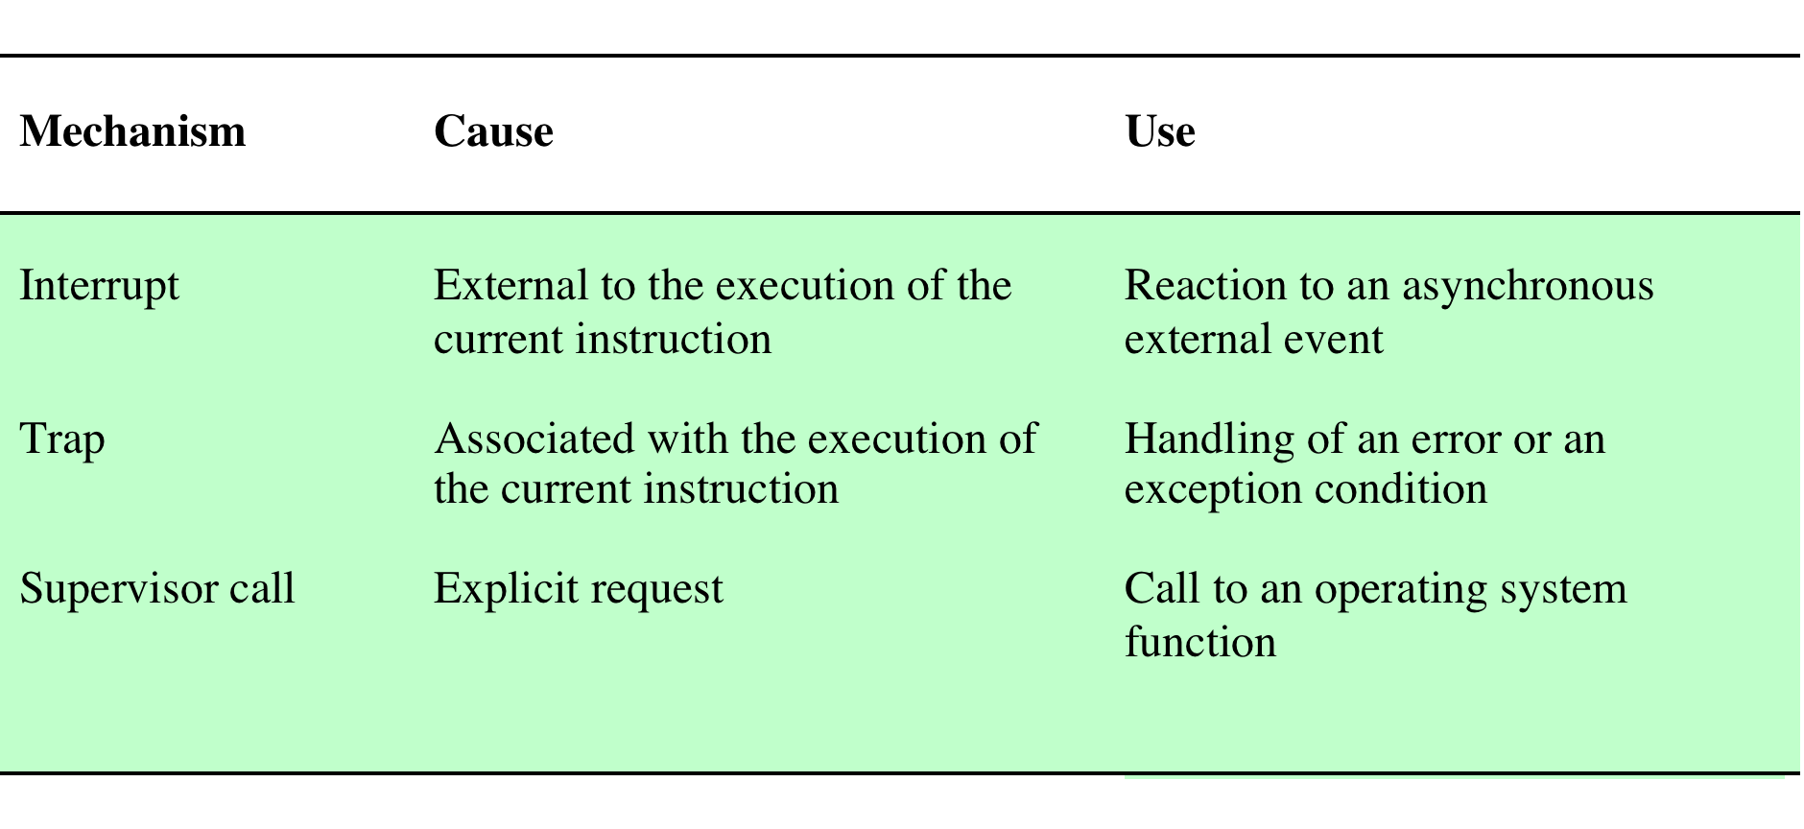
Process Switching
A process switch may occur any time that the OS has gained control from the currently running process. Possible events giving OS control are:
Notes:
A process switch may occur any time that the OS has
gained control from the currently running process. Table 3.8 suggests the possible
events that may give control to the OS.

Slide 27
System Interrupts
Interrupt
Trap
Due to some sort of event that is external to and independent of the currently running process
clock interrupt
I/O interrupt
memory fault
Time slice
the maximum amount of time that a process can execute before being interrupted
An error or exception condition generated within the currently running process
OS determines if the condition is fatal
moved to the Exit state and a process switch occurs
action will depend on the nature of the error
Notes:
First, let us consider system interrupts. Actually, we can distinguish, as many
systems do, two kinds of system interrupts, one of which is simply referred to as an
interrupt, and the other as a trap. The former is due to some sort of event that is
external to and independent of the currently running process, such as the completion
of an I/O operation. The latter relates to an error or exception condition generated
within the currently running process, such as an illegal file access attempt. With an
ordinary interrupt , control is first transferred to an interrupt handler, which does
some basic housekeeping and then branches to an OS routine that is concerned with
the particular type of interrupt that has occurred. Examples include the following:
• Clock interrupt: The OS determines whether the currently running process
has been executing for the maximum allowable unit of time, referred to as a
time slice . That is, a time slice is the maximum amount of time that a process
can execute before being interrupted. If so, this process must be switched to a
Ready state and another process dispatched.
• I/O interrupt: The OS determines what I/O action has occurred. If the I/O
action constitutes an event for which one or more processes are waiting,
then the OS moves all of the corresponding blocked processes to the Ready
state (and Blocked/Suspend processes to the Ready/Suspend state). The OS
must then decide whether to resume execution of the process currently in
the Running state or to preempt that process for a higher-priority Ready
process.
• Memory fault: The processor encounters a virtual memory address reference
for a word that is not in main memory. The OS must bring in the block
(page or segment) of memory containing the reference from secondary memory
to main memory. After the I/O request is issued to bring in the block of
memory, the process with the memory fault is placed in a blocked state; the
OS then performs a process switch to resume execution of another process.
After the desired block is brought into memory, that process is placed in the
Ready state.
With a trap , the OS determines if the error or exception condition is fatal.
If so, then the currently running process is moved to the Exit state and a process
switch occurs. If not, then the action of the OS will depend on the nature of
the error and the design of the OS. It may attempt some recovery procedure or
simply notify the user. It may do a process switch or resume the currently running
process.

Slide 28
Mode Switching
If no interrupts are pending the processor:
proceeds to the fetch stage and fetches the next instruction of the current program in the current process
If an interrupt is pending the processor:
sets the program counter to the starting address of an interrupt handler program
switches from user mode to kernel mode so that the interrupt processing code may include privileged instructions
Notes:
In Chapter 1 , we discussed the inclusion of an interrupt stage as
part of the instruction cycle. Recall that, in the interrupt stage, the processor checks
to see if any interrupts are pending, indicated by the presence of an interrupt signal.
If no interrupts are pending, the processor proceeds to the fetch stage and fetches
the next instruction of the current program in the current process. If an interrupt is
pending, the processor does the following:
1. It sets the program counter to the starting address of an interrupt handler
program.
2. It switches from user mode to kernel mode so that the interrupt processing
code may include privileged instructions.
The processor now proceeds to the fetch stage and fetches the first instruction of
the interrupt handler program, which will service the interrupt. At this point, typically,
the context of the process that has been interrupted is saved into that process
control block of the interrupted program.
One question that may now occur to you is, What constitutes the context that
is saved? The answer is that it must include any information that may be altered by
the execution of the interrupt handler and that will be needed to resume the program
that was interrupted. Thus, the portion of the process control block that was
referred to as processor state information must be saved. This includes the program
counter, other processor registers, and stack information.
Does anything else need to be done? That depends on what happens next. The
interrupt handler is typically a short program that performs a few basic tasks related
to an interrupt. For example, it resets the flag or indicator that signals the presence
of an interrupt. It may send an acknowledgment to the entity that issued the interrupt,
such as an I/O module. And it may do some basic housekeeping relating to the
effects of the event that caused the interrupt. For example, if the interrupt relates
to an I/O event, the interrupt handler will check for an error condition. If an error
has occurred, the interrupt handler may send a signal to the process that originally
requested the I/O operation. If the interrupt is by the clock, then the handler will
hand control over to the dispatcher, which will want to pass control to another process
because the time slice allotted to the currently running process has expired.
What about the other information in the process control block? If this interrupt
is to be followed by a switch to another process, then some work will need to be
done. However, in most operating systems, the occurrence of an interrupt does not
necessarily mean a process switch. It is possible that, after the interrupt handler has
executed, the currently running process will resume execution. In that case, all that
is necessary is to save the processor state information when the interrupt occurs and
restore that information when control is returned to the program that was running.
Typically, the saving and restoring functions are performed in hardware.

Slide 29
Change of Process State
The steps in a full process switch are:
save the context of the processor
update the process control block of the process currently in the Running state
move the process control block of this process to the appropriate queue
select another process for execution
update the process control block of the process selected
update memory management data structures
restore the context of the processor to that which existed at the time the selected process was last switched out
If the currently running process is to be moved to another state (Ready, Blocked, etc.), then the OS must make substantial changes in its environment
Notes:
It is clear, then, that the mode switch is a concept
distinct from that of the process switch. 10 A mode switch may occur without
changing the state of the process that is currently in the Running state. In that case,
the context saving and subsequent restoral involve little overhead. However, if the
currently running process is to be moved to another state (Ready, Blocked, etc.),
then the OS must make substantial changes in its environment. The steps involved
in a full process switch are as follows:
1. Save the context of the processor, including program counter and other
registers.
2. Update the process control block of the process that is currently in the
Running state. This includes changing the state of the process to one of the
other states (Ready; Blocked; Ready/Suspend; or Exit). Other relevant fields
must also be updated, including the reason for leaving the Running state and
accounting information.
3. Move the process control block of this process to the appropriate queue
(Ready; Blocked on Event i ; Ready/Suspend).
4. Select another process for execution; this topic is explored in Part Four.
5. Update the process control block of the process selected. This includes changing
the state of this process to Running.
6. Update memory management data structures. This may be required, depending
on how address translation is managed; this topic is explored in Part Three.
7. Restore the context of the processor to that which existed at the time the
selected process was last switched out of the Running state, by loading in the
previous values of the program counter and other registers.
Thus, the process switch, which involves a state change, requires more effort than a
mode switch.

Slide 30
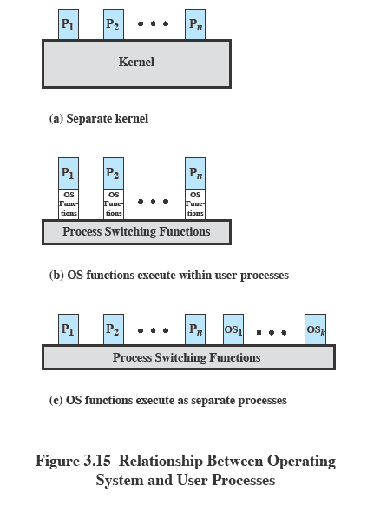
Execution of the Operating System
Notes:
One traditional approach, common on many older operating systems, is to execute
the kernel of the OS outside of any process ( Figure 3.15a ). With this approach,
when the currently running process is interrupted or issues a supervisor call, the
mode context of this process is saved and control is passed to the kernel. The OS has
its own region of memory to use and its own system stack for controlling procedure
calls and returns. The OS can perform any desired functions and restore the context
of the interrupted process, which causes execution to resume in the interrupted
user process. Alternatively, the OS can complete the function of saving the environment
of the process and proceed to schedule and dispatch another process. Whether
this happens depends on the reason for the interruption and the circumstances at
the time.
In any case, the key point here is that the concept of process is considered to
apply only to user programs. The operating system code is executed as a separate
entity that operates in privileged mode.
Execution within User Processes
An alternative that is common with operating systems on smaller computers (PCs,
workstations) is to execute virtually all OS software in the context of a user process.
The view is that the OS is primarily a collection of routines that the user calls to
perform various functions, executed within the environment of the user’s process.
This is illustrated in Figure 3.15b . At any given point, the OS is managing n process
images. Each image includes not only the regions illustrated in Figure 3.13 , but also
program, data, and stack areas for kernel programs.
Process-Based Operating System
Another alternative, illustrated in Figure 3.15c , is to implement the OS as a collection
of system processes. As in the other options, the software that is part of the
kernel executes in a kernel mode. In this case, however, major kernel functions are
organized as separate processes. Again, there may be a small amount of process switching
code that is executed outside of any process.
This approach has several advantages. It imposes a program design discipline
that encourages the use of a modular OS with minimal, clean interfaces between the
modules. In addition, some noncritical operating system functions are conveniently
implemented as separate processes. For example, we mentioned earlier a monitor
program that records the level of utilization of various resources (processor, memory,
channels) and the rate of progress of the user processes in the system. Because
this program does not provide a particular service to any active process, it can only
be invoked by the OS. As a process, the function can run at an assigned priority
level and be interleaved with other processes under dispatcher control. Finally,
implementing the OS as a set of processes is useful in a multiprocessor or multicomputer
environment, in which some of the operating system services can be shipped
out to dedicated processors, improving performance.

Slide 31
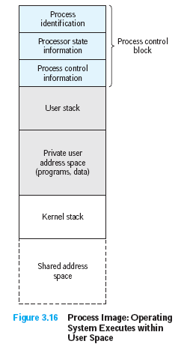
Execution Within User Processes
Notes:
Figure 3.16 suggests a typical process image structure for this strategy. A separate
kernel stack is used to manage calls/returns while the process is in kernel mode.
Operating system code and data are in the shared address space and are shared by
all user processes.
When an interrupt, trap, or supervisor call occurs, the processor is placed in
kernel mode and control is passed to the OS. To pass control from a user program
to the OS, the mode context is saved and a mode switch takes place to an operating
system routine. However, execution continues within the current user process. Thus,
a process switch is not performed, just a mode switch within the same process.
If the OS, upon completion of its work, determines that the current process
should continue to run, then a mode switch resumes the interrupted program within
the current process. This is one of the key advantages of this approach: A user
program has been interrupted to employ some operating system routine, and then
resumed, and all of this has occurred without incurring the penalty of two process
switches. If, however, it is determined that a process switch is to occur rather than
returning to the previously executing program, then control is passed to a process-
switching routine. This routine may or may not execute in the current process,
depending on system design. At some point, however, the current process has to be
placed in a nonrunning state and another process designated as the running process.
During this phase, it is logically most convenient to view execution as taking place
outside of all processes.
In a way, this view of the OS is remarkable. Simply put, at certain points in
time, a process will save its state information, choose another process to run from
among those that are ready, and relinquish control to that process. The reason this
is not an arbitrary and indeed chaotic situation is that during the critical time, the
code that is executed in the user process is shared operating system code and not
user code. Because of the concept of user mode and kernel mode, the user cannot
tamper with or interfere with the operating system routines, even though they are
executing in the user’s process environment. This further reminds us that there is
a distinction between the concepts of process and program and that the relationship
between the two is not one to one. Within a process, both a user program and
operating system programs may execute, and the operating system programs that
execute in the various user processes are identical.

Slide 32
Security Issues
An OS associates a set of privileges with each process
Typically a process that executes on behalf of a user has the privileges that the OS recognizes for that user
Highest level of privilege is referred to as adminstrator, supervisor, or root access
A key security issue in the design of any OS is to prevent, or at least detect, attempts by a user or a malware from gaining unauthorized privileges on the system and from gaining root access
Notes:
An OS associates a set of privileges with each process. These privileges dictate what
resources the process may access, including regions of memory, files, privileged system
instructions, and so on. Typically, a process that executes on behalf of a user
has the privileges that the OS recognizes for that user. A system or utility process
may have privileges assigned at configuration time.
On a typical system, the highest level of privilege is referred to as administrator,
supervisor, or root access. 11 Root access provides access to all the functions and
services of the operating system. With root access, a process has complete control of
the system and can add or change programs and files, monitor other processes, send
and receive network traffic, and alter privileges.
A key security issue in the design of any OS is to prevent, or at least detect,
attempts by a user or a piece of malicious software (malware) from gaining unauthorized
privileges on the system and, in particular, from gaining root access. In
this section, we briefly summarize the threats and countermeasures related to this
security issue. Part Seven provides more detail.

Slide 33

Process Termination
There must be a means for a process to indicate its completion
A batch job should include a HALT instruction or an explicit OS service call for termination
For an interactive application, the action of the user will indicate when the process is completed (e.g. log off, quitting an application)
Notes:
Any computer system must provide a means for a process to indicate its
completion. A batch job should include a Halt instruction or an explicit OS service
call for termination. In the former case, the Halt instruction will generate an interrupt
to alert the OS that a process has completed. For an interactive application, the action
of the user will indicate when the process is completed. For example, in a time-sharing
system, the process for a particular user is to be terminated when the user logs off or
turns off his or her terminal. On a personal computer or workstation, a user may quit
an application (e.g., word processing or spreadsheet). All of these actions ultimately
result in a service request to the OS to terminate the requesting process.

Slide 34
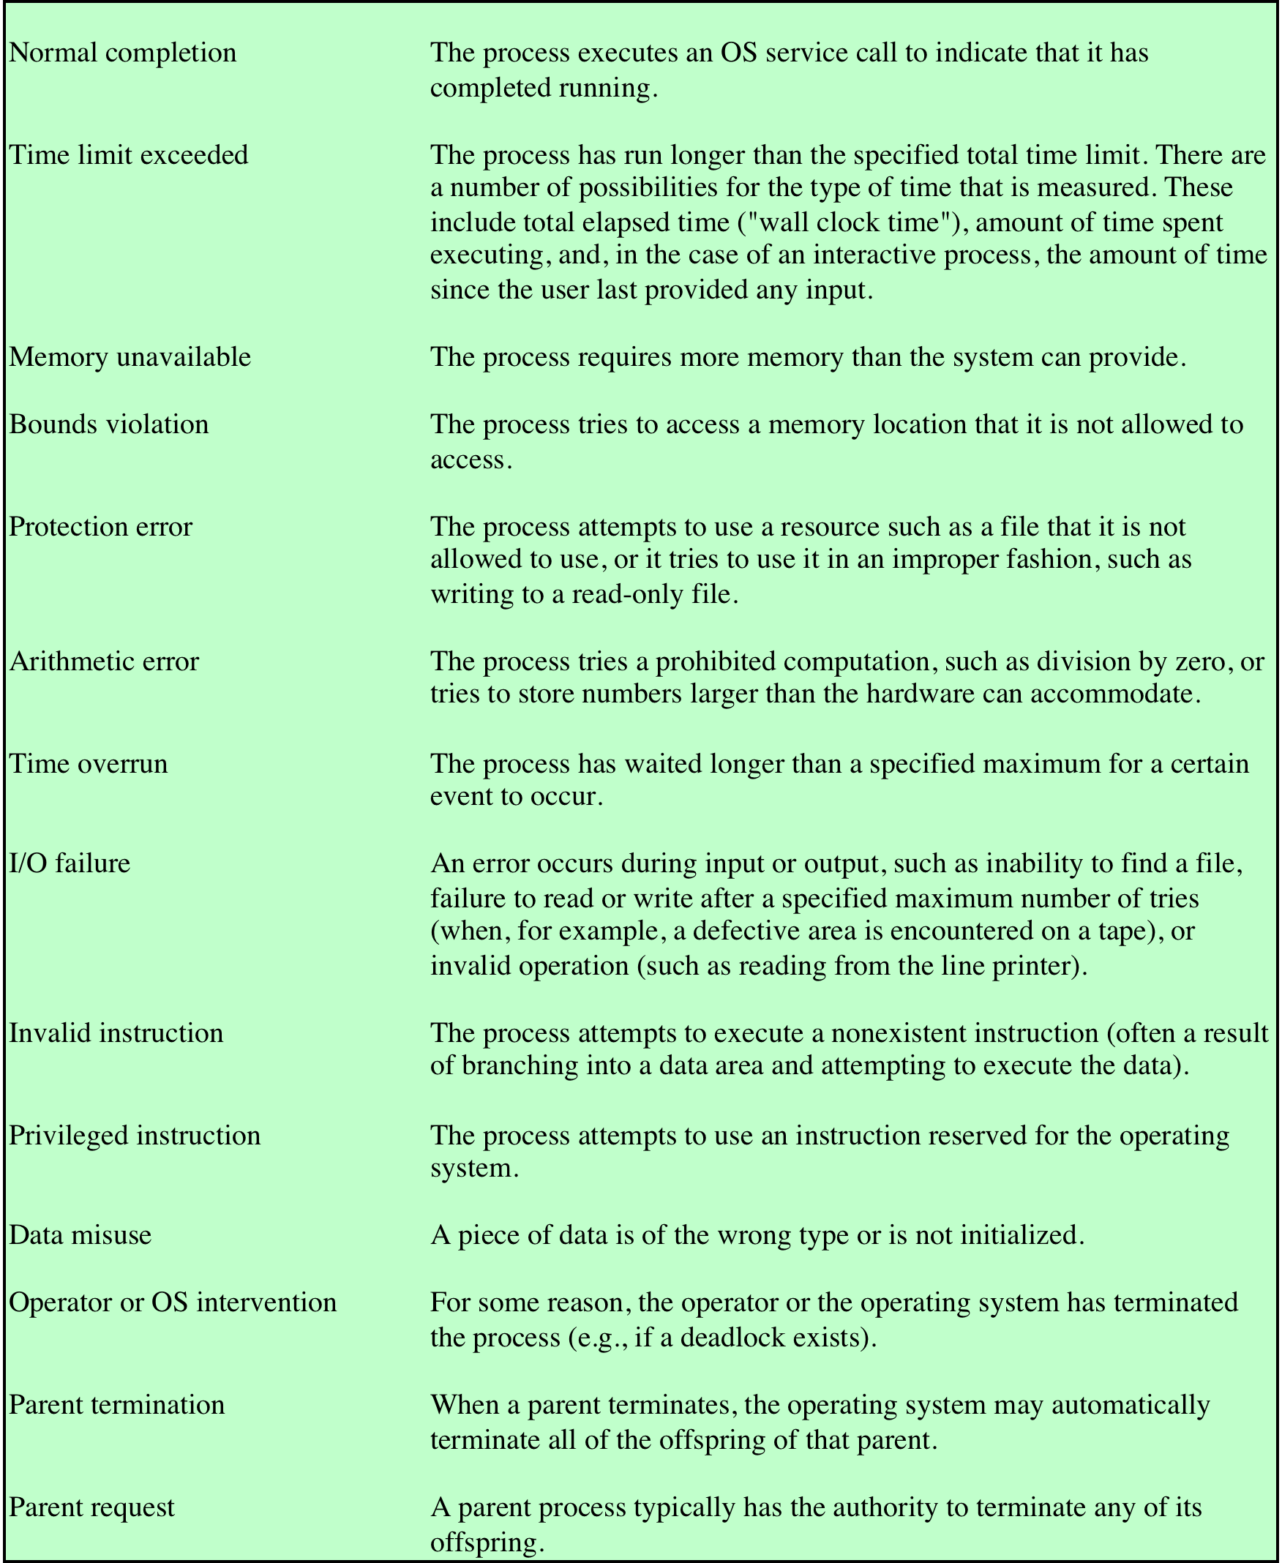
Table 3.2
Reasons for Process Termination
Notes:
Additionally, a number of error and fault conditions can lead to the termination
of a process. Table 3.2 lists some of the more commonly recognized conditions. 3
Finally, in some operating systems, a process may be terminated by the process
that created it or when the parent process is itself terminated.

Slide 35
Process Termination
A process terminates when it finishes executing it’s final statement and ask the OS to delete it by using exit() system call.
The process may return a status value (typically an integer) to it’s parent by using wait() system call.
All the resources of the process including physical and virtual memory, open files, I/O buffers are deallocated by the OS.

Slide 36
Zombie Process
A process becomes a zombie process when it has completed execution but one or some of its entries are still in the process table.
If a process is ended by an "exit" call, the process’ entry in the process table remains until the parent process acknowledges its execution, after which it is removed.
The time between the execution and the acknowledgment of the process is the period when the process is in a zombie state(defunct process).

Slide 37
Suspended Processes
Swapping
involves moving part of all of a process from main memory to disk
when none of the processes in main memory is in the Ready state, the OS swaps one of the blocked processes out on to the disk into a suspend queue
Notes:
Recall that the reason for all of this elaborate machinery is that I/O activities
are much slower than computation and therefore the processor in a uniprogramming
system is idle most of the time. But the arrangement of Figure 3.8b does not entirely
solve the problem. It is true that, in this case, memory holds multiple processes and
that the processor can move to another process when one process is blocked. But the
processor is so much faster than I/O that it will be common for all of the processes in
memory to be waiting for I/O. Thus, even with multiprogramming, a processor could
be idle most of the time.
What to do? Main memory could be expanded to accommodate more processes.
But there are two flaws in this approach. First, there is a cost associated with
main memory, which, though small on a per-byte basis, begins to add up as we get
into the gigabytes of storage. Second, the appetite of programs for memory has
grown as fast as the cost of memory has dropped. So larger memory results in larger
processes, not more processes.
Another solution is swapping, which involves moving part or all of a process
from main memory to disk. When none of the processes in main memory is in the
Ready state, the OS swaps one of the blocked processes out on to disk into a suspend
queue. This is a queue of existing processes that have been temporarily kicked
out of main memory, or suspended. The OS then brings in another process from the
suspend queue, or it honors a new-process request. Execution then continues with
the newly arrived process.
Swapping, however, is an I/O operation, and therefore there is the potential
for making the problem worse, not better. But because disk I/O is generally the
fastest I/O on a system (e.g., compared to tape or printer I/O), swapping will usually
enhance performance.

Slide 38
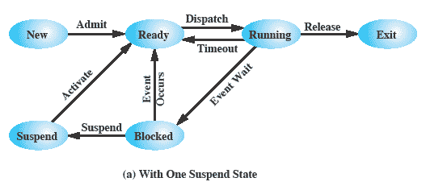
One Suspend State
Notes:
With the use of swapping as just described, one other state must be added to
our process behavior model ( Figure 3.9a ): the Suspend state. When all of the processes
in main memory are in the Blocked state, the OS can suspend one process by
putting it in the Suspend state and transferring it to disk. The space that is freed in
main memory can then be used to bring in another process.
When the OS has performed a swapping-out operation, it has two choices for
selecting a process to bring into main memory: It can admit a newly created process
or it can bring in a previously suspended process. It would appear that the preference
should be to bring in a previously suspended process, to provide it with service
rather than increasing the total load on the system.
But this line of reasoning presents a difficulty. All of the processes that have
been suspended were in the Blocked state at the time of suspension. It clearly would
not do any good to bring a blocked process back into main memory, because it is
still not ready for execution. Recognize, however, that each process in the Suspend
state was originally blocked on a particular event. When that event occurs, the process
is not blocked and is potentially available for execution.

Slide 39
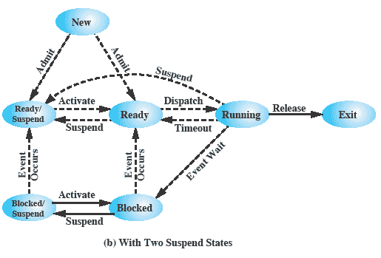
Two Suspend States
Notes:
Let us look now, in Figure 3.9b , at the state transition model that we have
developed. (The dashed lines in the figure indicate possible but not necessary transitions.)
Important new transitions are the following:
• Blocked : Blocked/Suspend: If there are no ready processes, then at least
one blocked process is swapped out to make room for another process that
is not blocked. This transition can be made even if there are ready processes
available, if the OS determines that the currently running process or a ready
process that it would like to dispatch requires more main memory to maintain
adequate performance.
• Blocked/Suspend : Ready/Suspend: A process in the Blocked/Suspend state
is moved to the Ready/Suspend state when the event for which it has been
waiting occurs. Note that this requires that the state information concerning
suspended processes must be accessible to the OS.
• Ready/Suspend : Ready: When there are no ready processes in main memory,
the OS will need to bring one in to continue execution. In addition, it
might be the case that a process in the Ready/Suspend state has higher priority
than any of the processes in the Ready state. In that case, the OS designer may
dictate that it is more important to get at the higher-priority process than to
minimize swapping.
• Ready : Ready/Suspend: Normally, the OS would prefer to suspend a
blocked process rather than a ready one, because the ready process can now
be executed, whereas the blocked process is taking up main memory space
and cannot be executed. However, it may be necessary to suspend a ready
process if that is the only way to free up a sufficiently large block of main
memory. Also, the OS may choose to suspend a lower–priority ready process
rather than a higher–priority blocked process if it believes that the blocked
process will be ready soon.

Slide 40
Characteristics of a Suspended Process
The process is not immediately available for execution
The process may or may not be waiting on an event
The process was placed in a suspended state by an agent: either itself, a parent process, or the OS, for the purpose of preventing its execution
The process may not be removed from this state until the agent explicitly orders the removal
Notes:
We can generalize the concept of a suspended process. Let us define a
suspended process as having the following characteristics:
1. The process is not immediately available for execution.
2. The process may or may not be waiting on an event. If it is, this blocked condition
is independent of the suspend condition, and occurrence of the blocking
event does not enable the process to be executed immediately.
The process was placed in a suspended state by an agent: either itself, a parent
process, or the OS, for the purpose of preventing its execution.
4. The process may not be removed from this state until the agent explicitly
orders the removal.

Slide 41
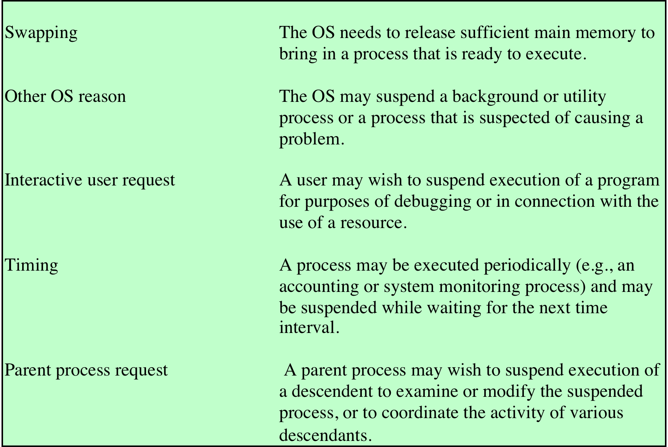
Reasons for Process Suspension
Table 3.3 Reasons for Process Suspension
Notes:
Table 3.3 lists some reasons for the suspension of a process. One reason that
we have discussed is to provide memory space either to bring in a Ready/Suspended
process or to increase the memory allocated to other Ready processes. The OS may
have other motivations for suspending a process. For example, an auditing or tracing
process may be employed to monitor activity on the system; the process may
be used to record the level of utilization of various resources (processor, memory,
channels) and the rate of progress of the user processes in the system. The OS,
under operator control, may turn this process on and off from time to time. If the
OS detects or suspects a problem, it may suspend a process. One example of this
is deadlock, which is discussed in Chapter 6 . As another example, a problem is
detected on a communications line, and the operator has the OS suspend the process
that is using the line while some tests are run.
Another set of reasons concerns the actions of an interactive user. For example, if
a user suspects a bug in the program, he or she may debug the program by suspending
its execution, examining and modifying the program or data, and resuming execution.
Or there may be a background process that is collecting trace or accounting statistics,
which the user may wish to be able to turn on and off.
Timing considerations may also lead to a swapping decision. For example, if a
process is to be activated periodically but is idle most of the time, then it should be
swapped out between uses. A program that monitors utilization or user activity is
an example.
Finally, a parent process may wish to suspend a descendent process. For example,
process A may spawn process B to perform a file read. Subsequently, process B
encounters an error in the file read procedure and reports this to process A. Process
A suspends process B to investigate the cause.
In all of these cases, the activation of a suspended process is requested by the
agent that initially requested the suspension.

Slide 42
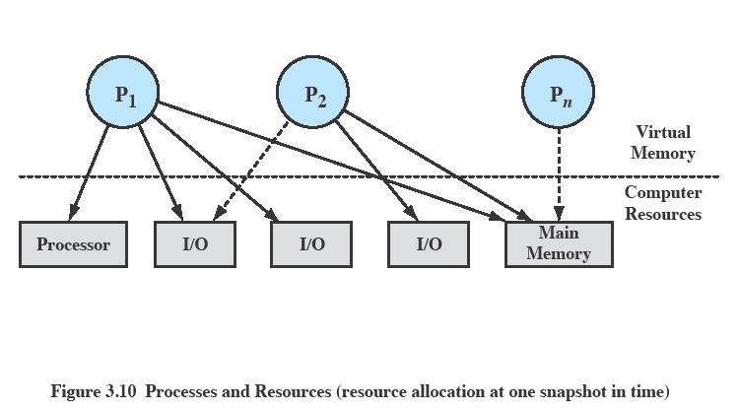
Processes and Resources
Notes:
The OS controls events within the computer system. It schedules and dispatches
processes for execution by the processor, allocates resources to processes, and
responds to requests by user processes for basic services. Fundamentally, we can
think of the OS as that entity that manages the use of system resources by processes.
This concept is illustrated in Figure 3.10 . In a multiprogramming environment,
there are a number of processes (P 1 ,…, P n ) that have been created and exist in
virtual memory. Each process, during the course of its execution, needs access to
certain system resources, including the processor, I/O devices, and main memory. In
the figure, process P 1 is running; at least part of the process is in main memory, and
it has control of two I/O devices. Process P 2 is also in main memory but is blocked
waiting for an I/O device allocated to P 1 . Process P n has been swapped out and is
therefore suspended.

Slide 43
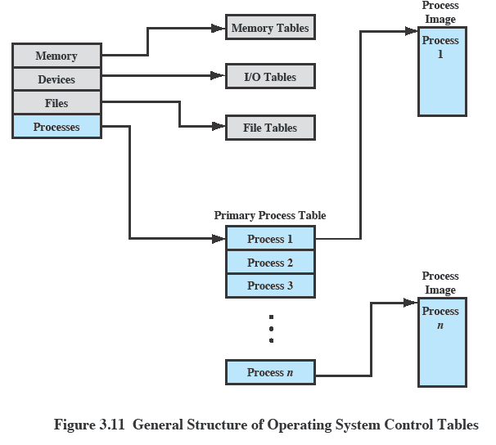
OS Control Tables
Notes:
If the OS is to manage processes and resources, it must have information about
the current status of each process and resource. The universal approach to providing
this information is straightforward: The OS constructs and maintains tables of
information about each entity that it is managing. A general idea of the scope of this
effort is indicated in Figure 3.11 , which shows four different types of tables maintained
by the OS: memory, I/O, file, and process. Although the details will differ
from one OS to another, fundamentally, all operating systems maintain information
in these four categories.
Figure 3.11 depicts the structure of the location information in the following
way. There is a primary process table with one entry for each process. Each
entry contains, at least, a pointer to a process image. If the process image contains
multiple blocks, this information is contained directly in the primary process
table or is available by cross-reference to entries in memory tables. Of course,
this depiction is generic; a particular OS will have its own way of organizing the
location information.

Slide 44
Memory Tables
Used to keep track of both main (real) and secondary (virtual) memory
Processes are maintained on secondary memory using some sort of virtual memory or simple swapping mechanism
Must include:
allocation of main memory to processes
allocation of secondary memory to processes
protection attributes of blocks of main or virtual memory
information needed to manage virtual memory
Notes:
Memory tables are used to keep track of both main (real) and secondary
(virtual) memory. Some of main memory is reserved for use by the OS; the
remainder is available for use by processes. Processes are maintained on secondary
memory using some sort of virtual memory or simple swapping mechanism. The
memory tables must include the following information:
• The allocation of main memory to processes
• The allocation of secondary memory to processes
Any protection attributes of blocks of main or virtual memory, such as which
processes may access certain shared memory regions
• Any information needed to manage virtual memory
We examine the information structures for memory management in detail in Part
Three.

Slide 45
I/O Tables
Used by the OS to manage the I/O devices and channels of the computer system
At any given time, an I/O device may be available or assigned to a particular process
If an I/O operation is in progress, the OS needs to know:
the status of the I/O operation
the location in main memory being used as the source or destination of the I/O transfer
Notes:
I/O tables are used by the OS to manage the I/O devices and channels of the
computer system. At any given time, an I/O device may be available or assigned to a
particular process. If an I/O operation is in progress, the OS needs to know the status
of the I/O operation and the location in main memory being used as the source or
destination of the I/O transfer. I/O management is examined in Chapter 11 .

Slide 46
File Tables
These tables provide information about:
existence of files
location on secondary memory
current status
other attributes
Information may be maintained and used by a file management system
in which case the OS has little or no knowledge of files
In other operating systems, much of the detail of file management is managed by the OS itself
Notes:
The OS may also maintain file tables.
Much, if not all, of this information may be maintained and used by a file management system, in which case the OS has little or no knowledge of files.
In other operating systems, much of the detail of file management is managed by the OS itself.

Slide 47
Process Tables
Must be maintained to manage processes
There must be some reference to memory, I/O, and files, directly or indirectly
The tables themselves must be accessible by the OS and therefore are subject to memory management
Notes:
Finally, the OS must maintain process tables to manage processes. The
remainder of this section is devoted to an examination of the required process
tables. Before proceeding to this discussion, two additional points should be made.
First, although Figure 3.11 shows four distinct sets of tables, it should be clear that
these tables must be linked or cross-referenced in some fashion. Memory, I/O, and
files are managed on behalf of processes, so there must be some reference to these
resources, directly or indirectly, in the process tables. The files referred to in the file
tables are accessible via an I/O device and will, at some times, be in main or virtual
memory. The tables themselves must be accessible by the OS and therefore are subject
to memory management.
Second, how does the OS know to create the tables in the first place? Clearly,
the OS must have some knowledge of the basic environment, such as how much main
memory exists, what are the I/O devices and what are their identifiers, and so on. This
is an issue of configuration. That is, when the OS is initialized, it must have access to
some configuration data that define the basic environment, and these data must be
created outside the OS, with human assistance or by some auto configuration software.

Slide 48
Process Control Structures
To manage and control a process the OS must know:
where the process is located
the attributes of the process that are necessary for its management
Notes:
Consider what the OS must know if it is to manage and control a process. First, it
must know where the process is located; second, it must know the attributes of the
process that are necessary for its management (e.g., process ID and process state).

Slide 49
Process Control Structures
Process Location
Process Attributes
A process must include a program or set of programs to be executed
A process will consist of at least sufficient memory to hold the programs and data of that process
The execution of a program typically involves a stack that is used to keep track of procedure calls and parameter passing between procedures
Each process has associated with it a number of attributes that are used by the OS for process control
The collection of program, data, stack, and attributes is referred to as the process image
Process image location will depend on the memory management scheme being used
Notes:
Before we can deal with the questions of where a process is
located or what its attributes are, we need to address an even more fundamental
question: What is the physical manifestation of a process? At a minimum, a process
must include a program or set of programs to be executed. Associated with these
programs is a set of data locations for local and global variables and any defined
constants. Thus, a process will consist of at least sufficient memory to hold the
programs and data of that process. In addition, the execution of a program typically
involves a stack (see Appendix P) that is used to keep track of procedure calls and
parameter passing between procedures. Finally, each process has associated with it
a number of attributes that are used by the OS for process control.
The location of a process image will depend on the memory management
scheme being used. In the simplest case, the process image is maintained as a
contiguous, or continuous, block of memory. This block is maintained in secondary
memory, usually disk. So that the OS can manage the process, at least a small portion
of its image must be maintained in main memory. To execute the process, the entire
process image must be loaded into main memory or at least virtual memory. Thus,
the OS needs to know the location of each process on disk and, for each such process
that is in main memory, the location of that process in main memory. We saw
a slightly more complex variation on this scheme with the CTSS OS, in Chapter 2 .
With CTSS, when a process is swapped out, part of the process image may remain in
main memory. Thus, the OS must keep track of which portions of the image of each
process are still in main memory.
Modern operating systems presume paging hardware that allows noncontiguous
physical memory to support partially resident processes. 8 At any given time, a
portion of a process image may be in main memory, with the remainder in secondary
memory. 9 Therefore, process tables maintained by the OS must show the location
of each page of each process image.

Slide 50

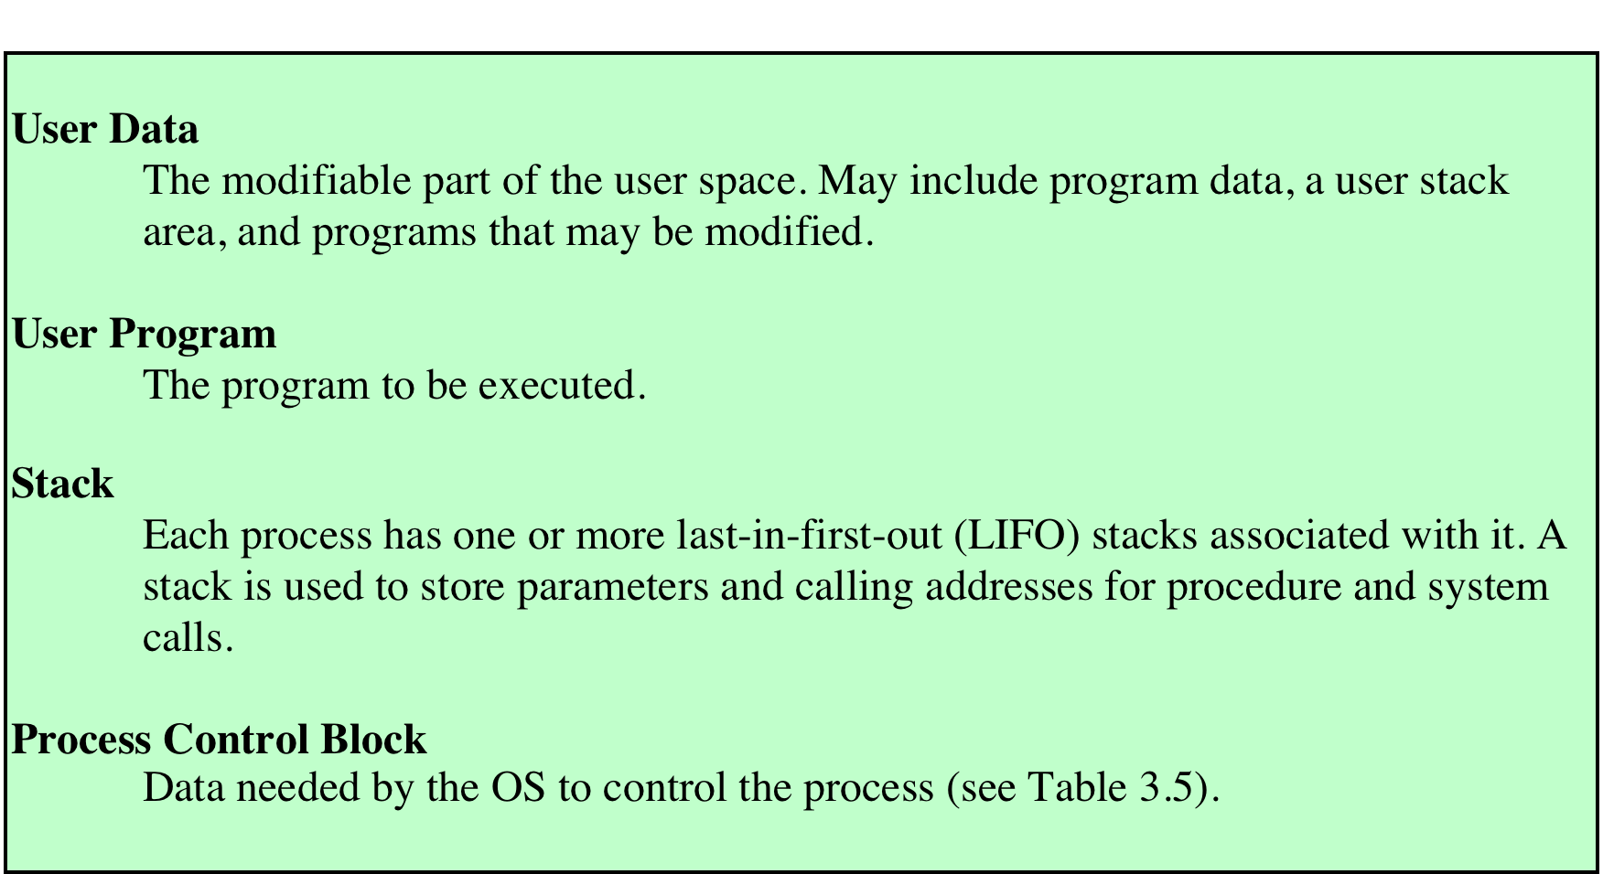
Typical Elements of a Process Image
Notes:
Typically, the collection of attributes is referred to as a process control block. 7 We can refer to this
collection of program, data, stack, and attributes as the process image ( Table 3.4 ).

Slide 51
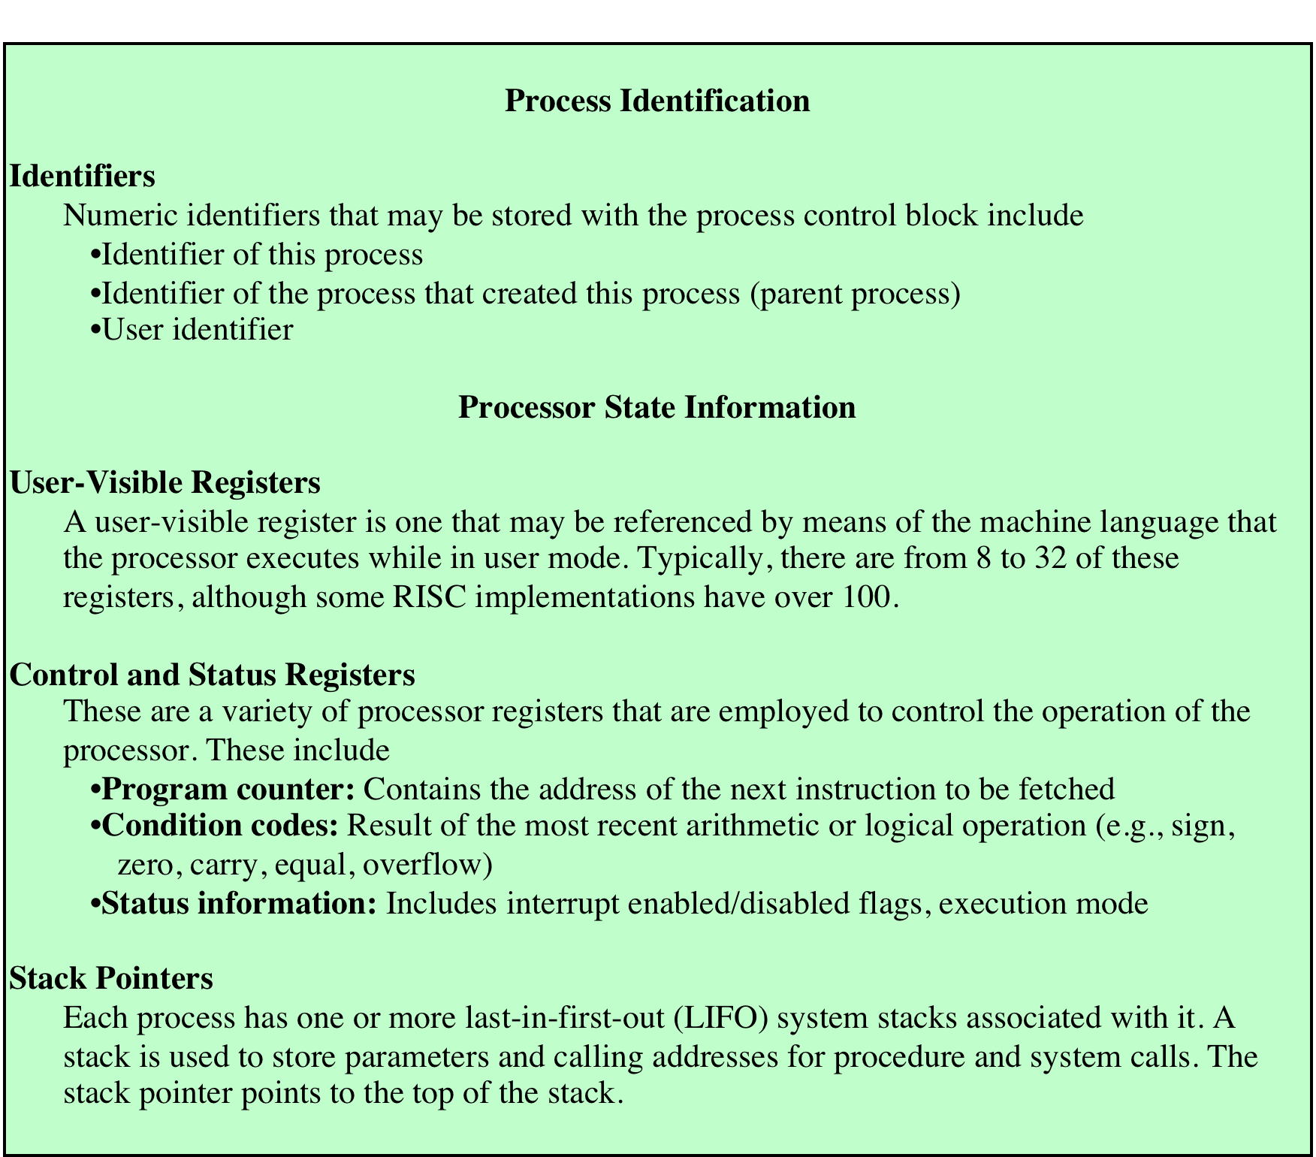
Process Attributes
Notes:
A sophisticated multiprogramming system requires a great
deal of information about each process. As was explained, this information can be
considered to reside in a process control block. Different systems will organize this
information in different ways, and several examples of this appear at the end of this
chapter and the next. For now, let us simply explore the type of information that
might be of use to an OS without considering in any detail how that information is
organized.
Table 3.5 lists the typical categories of information required by the OS for each
process. You may be somewhat surprised at the quantity of information required.
As you gain a greater appreciation of the responsibilities of the OS, this list should
appear more reasonable.
We can group the process control block information into three general
categories:
• Process identification
• Processor state information
• Process control information

Slide 52
Process Identification
Each process is assigned a unique numeric identifier
otherwise there must be a mapping that allows the OS to locate the appropriate tables based on the process identifier
Many of the tables controlled by the OS may use process identifiers to cross-reference process tables
Memory tables may be organized to provide a map of main memory with an indication of which process is assigned to each region
similar references will appear in I/O and file tables
When processes communicate with one another, the process identifier informs the OS of the destination of a particular communication
When processes are allowed to create other processes, identifiers indicate the parent and descendents of each process
Notes:
With respect to process identification , in virtually all operating systems, each
process is assigned a unique numeric identifier, which may simply be an index into
the primary process table ( Figure 3.11 ); otherwise there must be a mapping that
allows the OS to locate the appropriate tables based on the process identifier. This
identifier is useful in several ways. Many of the other tables controlled by the OS
may use process identifiers to cross-reference process tables. For example, the
memory tables may be organized so as to provide a map of main memory with an
indication of which process is assigned to each region. Similar references will appear
in I/O and file tables. When processes communicate with one another, the process
identifier informs the OS of the destination of a particular communication. When
processes are allowed to create other processes, identifiers indicate the parent and
descendents of each process.
In addition to these process identifiers, a process may be assigned a user identifier
that indicates the user responsible for the job.

Slide 53
Processor State Information
Consists of the contents of processor registers
user-visible registers
control and status registers
stack pointers
Program status word (PSW)
contains condition codes plus other status information
EFLAGS register is an example of a PSW used by any OS running on an x86 processor
Notes:
Processor state information consists of the contents of processor registers.
While a process is running, of course, the information is in the registers. When a
process is interrupted, all of this register information must be saved so that it can
be restored when the process resumes execution. The nature and number of registers
involved depend on the design of the processor. Typically, the register set will
include user-visible registers, control and status registers, and stack pointers. These
are described in Chapter 1 .
Of particular note, all processor designs include a register or set of registers,
often known as the program status word (PSW), that contains status information.
The PSW typically contain condition codes plus other status information. A good
example of a processor status word is that on Intel x86 processors, referred to as the
EFLAGS register (shown in Figure 3.12 and Table 3.6 ). This structure is used by
any OS (including UNIX and Windows) running on an x86 processor.

Slide 54
Process Control Information
The additional information needed by the OS to control and coordinate the various active processes
Notes:
The third major category of information in the process control block can be
called, for want of a better name, process control information . This is the additional
information needed by the OS to control and coordinate the various active
processes. The last part of Table 3.5 indicates the scope of this information. As
we examine the details of operating system functionality in succeeding chapters,
the need for the various items on this list should become clear.

Slide 55
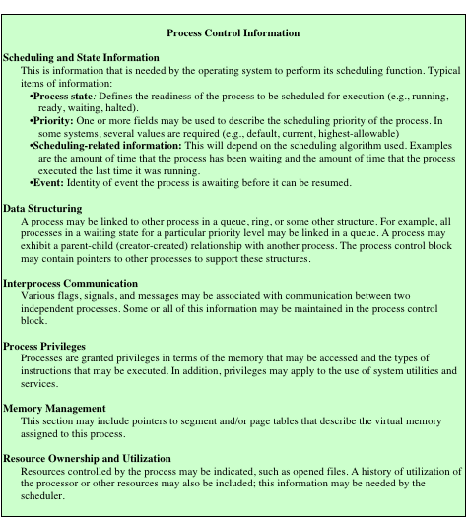
Typical
Elements
of a Process
Control Block
Notes:
Table 3.5 (continued)

Slide 56
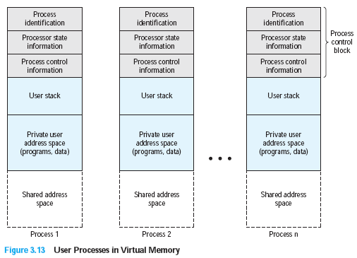
Structure of Process Images in Virtual Memory
Notes:
Figure 3.13 suggests the structure of process images in virtual memory. Each
process image consists of a process control block, a user stack, the private address
space of the process, and any other address space that the process shares with
other processes. In the figure, each process image appears as a contiguous range
of addresses. In an actual implementation, this may not be the case; it will depend
on the memory management scheme and the way in which control structures are
organized by the OS.

Slide 57
Role of the Process Control Block
The most important data structure in an OS
contains all of the information about a process that is needed by the OS
blocks are read and/or modified by virtually every module in the OS
defines the state of the OS
Difficulty is not access, but protection
a bug in a single routine could damage process control blocks, which could destroy the system’s ability to manage the affected processes
a design change in the structure or semantics of the process control block could affect a number of modules in the OS
Notes:
The process control block is the
most important data structure in an OS. Each process control block contains all
of the information about a process that is needed by the OS. The blocks are read
and/or modified by virtually every module in the OS, including those involved with
scheduling, resource allocation, interrupt processing, and performance monitoring
and analysis. One can say that the set of process control blocks defines the state of
the OS.
This brings up an important design issue. A number of routines within the OS
will need access to information in process control blocks. The provision of direct
access to these tables is not difficult. Each process is equipped with a unique ID, and
this can be used as an index into a table of pointers to the process control blocks.
The difficulty is not access but rather protection. Two problems present themselves:
• A bug in a single routine, such as an interrupt handler, could damage process
control blocks, which could destroy the system’s ability to manage the affected
processes.
• A design change in the structure or semantics of the process control block
could affect a number of modules in the OS.
These problems can be addressed by requiring all routines in the OS to go
through a handler routine, the only job of which is to protect process control blocks,
and which is the sole arbiter for reading and writing these blocks. The trade-off in
the use of such a routine involves performance issues and the degree to which the
remainder of the system software can be trusted to be correct.

Slide 58

Modes of Execution
User Mode
System Mode
less-privileged mode
user programs typically execute in this mode
more-privileged mode
also referred to as control mode or kernel mode
kernel of the operating system
Notes:
Before continuing with our discussion of the way in which the OS manages processes,
we need to distinguish between the mode of processor execution normally
associated with the OS and that normally associated with user programs. Most
processors support at least two modes of execution. Certain instructions can only
be executed in the more-privileged mode. These would include reading or altering
a control register, such as the program status word; primitive I/O instructions;
and instructions that relate to memory management. In addition, certain regions of
memory can only be accessed in the more-privileged mode.
The less-privileged mode is often referred to as the user mode , because user
programs typically would execute in this mode. The more-privileged mode is referred
to as the system mode , control mode , or kernel mode . This last term refers to the
kernel of the OS, which is that portion of the OS that encompasses the important
system functions.

Slide 59
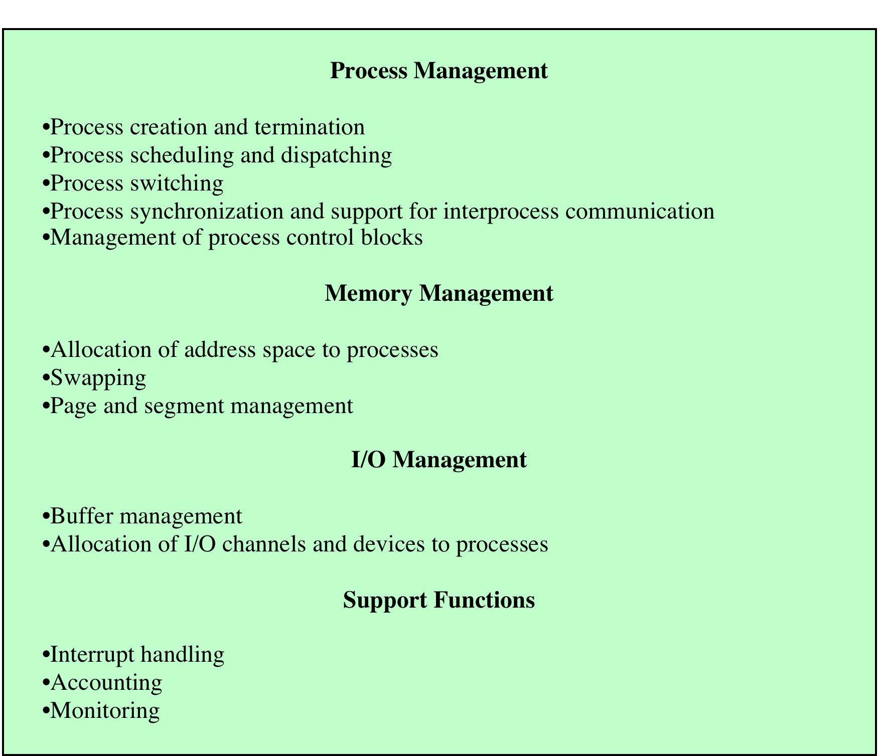
Table 3.7
Typical
Functions
of an
Operating
System
Kernel
Notes:
Table 3.7 lists the functions typically found in the kernel of an OS.

Slide 60
Kernel Mode vs user Mode
Kernel Mode
Can use the full instruction set of the CPU. Including:
Enabling / disabling interrupts
Setting special registers (page table pointer, interrupt table pointer, etc…)
Can modify any location in memory and modify page tables
User Mode
Cannot use privileged instructions.
Can only modify the memory assigned to the process.

Slide 61
Interrupts
An interrupt is an event that requires immediate attention from the CPU.
Interrupt handler is a Procedure for handling interrupts
Save all registers including the program counter to memory
CPU looks up the interrupt handler on the interrupt vector table and calls the interrupt handler
Once the interrupt handler is completed, it restores all registers and returns to the program counter.
It may optionally retry the instruction that caused the interrupt (in the case of a page fault).
The program continues execution, not knowing anything has happened

Slide 62
Context Switching
Context switches are caused by software and hardware interrupts
Save the context of the process that is currently running on the CPU. Update the process control block and other important fields.
Move the process control block of the above process into the relevant queue such as the ready queue, I/O queue etc.
Select a new process for execution.
Update the process control block of the selected process. This includes updating the process state to running.
Update the memory management data structures as required.
Restore the context of the process that was previously running when it is loaded again on the processor. This is done by loading the previous values of the process control block and registers.
Invoke the scheduler to find a ‘ready’ process and change its state to ‘running’
Restore registers for the new process and switch back to user mode.

Slide 63
Process Scheduling
CPU scheduling allows one process to utilize the processor when the execution of another process is on hold ( in waiting state)
Any process can be on hold due to unavailability of any resource like I/O, files hardware recourses etc,
The aim of CPU scheduling is to make the system efficient, fast, and fair.
Whenever the CPU becomes idle, the OS selects one of the processes in the ready queue for the execution.
The selection process is carried out by the short-term scheduler

Slide 64
Process Scheduling
Time Quantum - the allotted time slice a program is run before a scheduling decision. Typically less than or equal to a clock tick.
Clock - one of two triggers for the scheduling algorithm. On most CPUs, the clock ticks at a rate of 50-100Hz. Each clock tick issues a hardware interrupt which permits the operating system to run the scheduler
Context Switch - the process by which through a software or hardware interrupt, a process switches from user mode to kernel mode or from kernel mode to user mode

Slide 65
Process Scheduling
CPU scheduling decisions may take place under the following four circumstances:
When a process switches from the running state to the waiting state(for I/O request or invocation of wait for the termination of one of the child processes).
When a process switches from the running state to the ready state (for example, when an interrupt occurs).
When a process switches from the waiting state to the ready state(for example, completion of I/O).
When a process terminates

Slide 66
Objectives of Process Scheduling
Fairness: make sure each process gets its fair share of the CPU.
Efficiency: keep the CPU as busy as possible
Response time: minimize the response time for interactive users.
Turnaround: minimize the time batch users must wait for output
Throughput: maximize the number of jobs processed per hour

Slide 67
Process Scheduling
Non-Preemptive Scheduling
Under non-preemptive scheduling, once the CPU has been allocated to a process, the process keeps the CPU until it releases the CPU either by terminating or by switching to the waiting state.
CPU is not interrupted in the middle of execution of the current process. Instead, it waits till the process completes its CPU burst time, and then after that it can allocate the CPU to any other process.
Some Algorithms based on non-preemptive scheduling are:
Shortest Job First (Non preemptive version)
Priority Scheduling.(Non preemptive version)

Slide 68
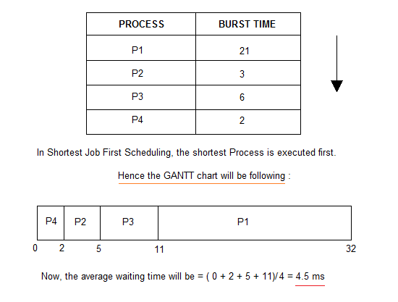
Process Scheduling - Non Pre-emptive Shortest Job First
Consider the below processes available in the ready queue for execution, with arrival time as 0 for all and given burst times.
Starvation

Slide 69
Priority Scheduling
Preemptive Priority Scheduling: If the new process with higher priority than the currently running process, arrived at the ready queue, the CPU is preempted,
Non-Preemptive Priority Scheduling: If the new process with higher priority than the currently running process, arrived at the ready queue, the CPU is not preempted instead, the incoming process is put at the head of the ready queue

Slide 70
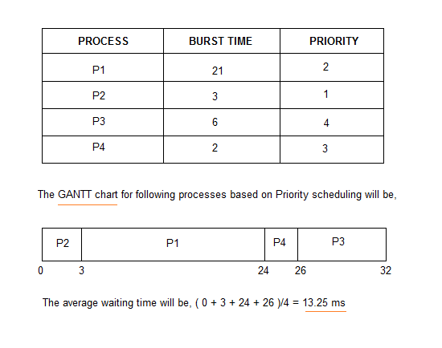
Priority Scheduling(Non preemptive version)
Starvation can be removed with aging

Slide 71
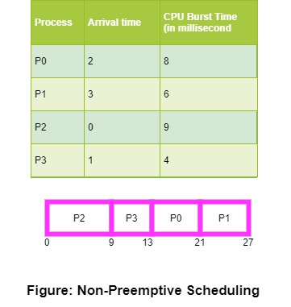
Priority Scheduling (Non preemptive version)

Slide 72
Pre-emptive Scheduling
Pre-emptive Scheduling
Processes are usually assigned with priorities.
It is necessary to run a certain task that has a higher priority before another task although it is running.
Therefore, the running task is interrupted for some time and resumed later when the priority task has finished its execution.
This type of scheduling is used mainly when a process switches either from running state to ready state or from waiting state to ready state.
Some Algorithms that are based on preemptive scheduling are
Round Robin Scheduling (RR),
Shortest Remaining Time First (SRTF),
Priority Scheduling (preemptive version)

Slide 73
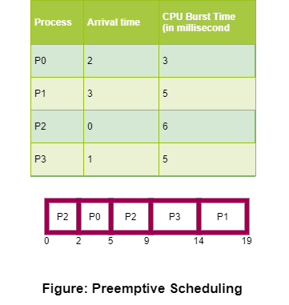
Pre-emptive Scheduling

Slide 74
Round Robin Scheduling (Pre-emptive version)
This algorithm is similar to FCFS scheduling, but in Round Robin(RR) scheduling, preemption is added which enables the system to switch between processes.
A fixed time is allotted to each process, called a quantum, for execution.
Once a process is executed for the given time period that process is preempted and another process executes for the given time period.
Context switching is used to save states of preempted processes.
This algorithm is simple and easy to implement and the most important is thing is this algorithm is starvation-free as all processes get a fair share of CPU.

Slide 75
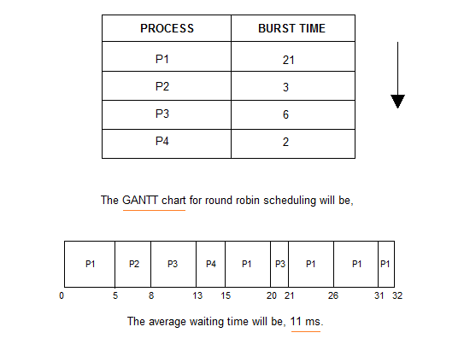
Round Robin Scheduling (Pre-emptive version)

Slide 76
Round Robin Scheduling (RR) – Advantages & Disadvantages
Advantages
All the jobs get a fair allocation of CPU.
There are no issues of starvation
Deals with all processes without any priority.
Cyclic in nature.
Disadvantages
This algorithm spends more time on context switches.
For small quantum, it is time-consuming scheduling.
This algorithm offers a larger waiting time and response time.
In this, there is low throughput.
If time quantum is less for scheduling then its Gantt chart seems to be too big.

Slide 77
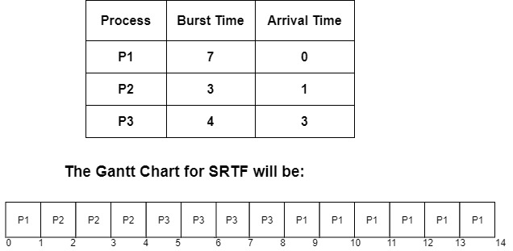
Shortest Remaining Time First (SRTF)
On arrival of every process, the scheduler schedules those processes from the ready queue that has the least remaining burst time.

Slide 78
Shortest Remaining Time First (SRTF)
Advantages: SRTF algorithm makes the processing of the jobs faster
Disadvantages: The context switch is done a lot more times which consumes CPU’s valuable time for processing.
This adds up to it’s processing time and diminishes it’s advantage of fast processing.

Slide 79
Threads
Threads are also known as Lightweight processes.
It is a basic unit of work.
Each process can have one or more threads in it which are intended to perform different tasks. Threads comprises of
Thread Id
Program counter
Register set
Stack
A thread shares with other threads within the same process -
It’s code section
Data section
Open files

Slide 80
Threads
Threads are independent unit of execution within a process.
Execution of a thread has to be initiated by a process.
Threads are a popular way to improve the performance of an application through parallelism.
The CPU switches rapidly back and forth among the threads giving the illusion that the threads are running in parallel.
Each thread belongs to exactly one process and outside a process no threads exist.

Slide 81
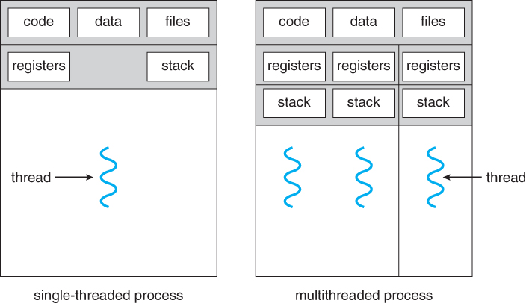
Threads
A traditional heavyweight process has a single thread. But if is has more than one thread then it can perform more than one task at a time.

Slide 82

Single Threaded vs Multithreaded process
In a single thread or threading, the process contains only one thread.
That thread executes all the tasks related to the process.
Multithreading - In a multi-threaded application, multiple threads are executed concurrently.
Each thread handles different tasks simultaneously by making optimal use of the resources.
The ability of an OS to support multiple, concurrent paths of execution within a single process
suspending a process involves suspending all threads of the process
termination of a process terminates all threads within the process
Department of Information Technology, VIIT, Pune-48
Notes:
To distinguish the two characteristics, the unit of dispatching is usually referred to as a thread or lightweight process , while the unit of resource ownership is usually referred to as a process or task .
Multithreading refers to the ability of an OS to support multiple, concurrent paths of execution within a single process.

Slide 83
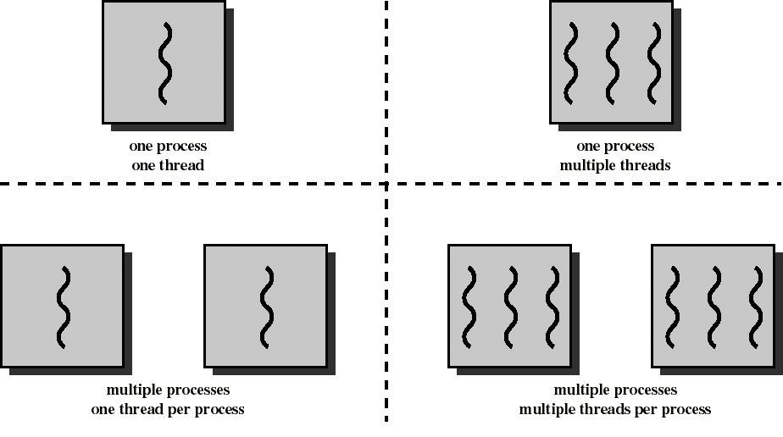
Threads

Slide 84
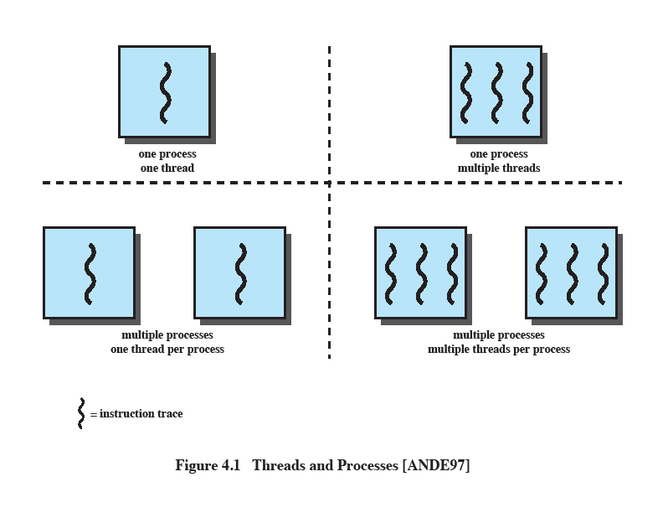
Single Threaded Approaches
A single execution path per process, in which the concept of a thread is not recognized, is referred to as a single-threaded approach
MS-DOS, some versions of UNIX supported only this type of process.
Department of Information Technology, VIIT, Pune-48
Notes:
The traditional approach of a single thread of execution per process, in which the concept of a thread is not recognized, is referred to as a single-threaded approach. The two arrangements shown in the left half of Figure 4.1 are single-threaded approaches. MS-DOS is an example of an OS that supports a single user process and a single thread.

Slide 85
Multithreaded Approaches
Most of the modern software applications in the system uses the concept of multi threading.
For eg. A web browser application can have multiple threads
One thread does the task of taking input from the user.
Second thread can send this request to the server
Third thread can retrieve the results from the server
Forth thread can display the images
Department of Information Technology, VIIT, Pune-48
Notes:
The right half of Figure 4.1 depicts multithreaded approaches. A Java run-time environment is an example of a system of one process with multiple threads. Of interest in this section is the use of multiple processes, each of which supports multiple threads. This approach is taken in Windows, Solaris, and many modern versions of UNIX, among others. In this section we give a general description of multithreading; the details of the Windows, Solaris, and Linux approaches are discussed later in this chapter.

Slide 86
Each thread has:
an execution state (Running, Ready, etc.)
saved thread context when not running (TCB)
an execution stack
some per-thread static storage for local variables
access to the shared memory and resources of its process (all threads of a process share this)
Any alteration of a resource by one thread affects the other threads in the same process
Department of Information Technology, VIIT, Pune-48
Notes:
Within a process, there may be one or more threads, each with the following:
• A thread execution state (Running, Ready, etc.)
• A saved thread context when not running; one way to view a thread is as an independent program counter operating within a process
• An execution stack
• Some per-thread static storage for local variables
• Access to the memory and resources of its process, shared with all other threads in that process

Slide 87
Thread Execution States
The key states for
a thread are:
Running
Ready
Blocked
Thread operations associated with a change in thread state are:
Spawn (create)
Block
Unblock
Finish
Department of Information Technology, VIIT, Pune-48
Notes:
THREAD STATES
As with processes, the key states for a thread are Running, Ready, and Blocked. Generally, it does not make sense to associate suspend states with threads because such states are process-level concepts. In particular, if a process is swapped out, all of its threads are necessarily swapped out because they all share the address space of the process. There are four basic thread operations associated with a change in thread state [ANDE04]:
• Spawn: Typically, when a new process is spawned, a thread for that process is also spawned. Subsequently, a thread within a process may spawn another thread within the same process, providing an instruction pointer and arguments for the new thread. The new thread is provided with its own register context and stack space and placed on the ready queue.
• Block: When a thread needs to wait for an event, it will block (saving its user registers, program counter, and stack pointers). The processor may now turn to the execution of another ready thread in the same or a different process.
• Unblock: When the event for which a thread is blocked occurs, the thread is moved to the Ready queue.
• Finish: When a thread completes, its register context and stacks are deallocated.

Slide 88
Thread Execution States
Process | Thread
A Process simply means any program in execution. | Thread simply means a segment of a process.
The process consumes more resources | Thread consumes fewer resources.
The process requires more time for creation. | Thread requires comparatively less time for creation than process.
The process is a heavyweight process | Thread is known as a lightweight process
The process takes more time to terminate | The thread takes less time to terminate.
Processes have independent data and code segments | A thread mainly shares the data segment, code segment, files, etc. with its peer threads.
The process takes more time for context switching. | The thread takes less time for context switching.
Communication between processes needs more time as compared to thread. | Communication between threads needs less time as compared to processes.
For some reason, if a process gets blocked then the remaining processes can continue their execution | In case if a user-level thread gets blocked, all of its peer threads also gets blocked.
Department of Information Technology, VIIT, Pune-48
Notes:
THREAD STATES
As with processes, the key states for a thread are Running, Ready, and Blocked. Generally, it does not make sense to associate suspend states with threads because such states are process-level concepts. In particular, if a process is swapped out, all of its threads are necessarily swapped out because they all share the address space of the process. There are four basic thread operations associated with a change in thread state [ANDE04]:
• Spawn: Typically, when a new process is spawned, a thread for that process is also spawned. Subsequently, a thread within a process may spawn another thread within the same process, providing an instruction pointer and arguments for the new thread. The new thread is provided with its own register context and stack space and placed on the ready queue.
• Block: When a thread needs to wait for an event, it will block (saving its user registers, program counter, and stack pointers). The processor may now turn to the execution of another ready thread in the same or a different process.
• Unblock: When the event for which a thread is blocked occurs, the thread is moved to the Ready queue.
• Finish: When a thread completes, its register context and stacks are deallocated.

Slide 89
Advantages of Threads
Threads minimize the context switching time.
Use of threads provides concurrency within a process.
Efficient communication.
It is more economical to create and context switch threads.
Threads allow utilization of multiprocessor architectures to a greater scale and efficiency.
Department of Information Technology, VIIT, Pune-48
Notes:
THREAD STATES
As with processes, the key states for a thread are Running, Ready, and Blocked. Generally, it does not make sense to associate suspend states with threads because such states are process-level concepts. In particular, if a process is swapped out, all of its threads are necessarily swapped out because they all share the address space of the process. There are four basic thread operations associated with a change in thread state [ANDE04]:
• Spawn: Typically, when a new process is spawned, a thread for that process is also spawned. Subsequently, a thread within a process may spawn another thread within the same process, providing an instruction pointer and arguments for the new thread. The new thread is provided with its own register context and stack space and placed on the ready queue.
• Block: When a thread needs to wait for an event, it will block (saving its user registers, program counter, and stack pointers). The processor may now turn to the execution of another ready thread in the same or a different process.
• Unblock: When the event for which a thread is blocked occurs, the thread is moved to the Ready queue.
• Finish: When a thread completes, its register context and stacks are deallocated.

Slide 90
Advantages of Threads
Takes less time to create a new thread than a process
Less time to terminate a thread than a process
Switching between two threads takes less time than switching between processes
Threads enhance efficiency in communication between programs
Department of Information Technology, VIIT, Pune-48
Notes:
Thus, all of the threads of a process share the state and resources of that process. They reside in the same address space and have access to the same data. When one thread alters an item of data in memory, other threads see the results if and when they access that item. If one thread opens a file with read privileges, other threads in the same process can also read from that file.
The key benefits of threads derive from the performance implications:
1. It takes far less time to create a new thread in an existing process than to
create a brand-new process. Studies done by the Mach developers show that
thread creation is ten times faster than process creation in UNIX [TEVA87].
2. It takes less time to terminate a thread than a process.
3. It takes less time to switch between two threads within the same process than to switch between processes.
4. Threads enhance efficiency in communication between different executing programs. In most operating systems, communication between independent processes requires the intervention of the kernel to provide protection and the mechanisms needed for communication. However, because threads within the same process share memory and files, they can communicate with each other without invoking the kernel.
Thus, if there is an application or function that should be implemented as a set of related units of execution, it is far more efficient to do so as a collection of threads rather than a collection of separate processes.

Slide 91
Types of Threads
Threads are implemented in following two ways −
User Level Threads − User managed threads.
Kernel Level Threads − Operating System managed threads acting on kernel, an operating system core.
Department of Information Technology, VIIT, Pune-48
Notes:
Thus, all of the threads of a process share the state and resources of that process. They reside in the same address space and have access to the same data. When one thread alters an item of data in memory, other threads see the results if and when they access that item. If one thread opens a file with read privileges, other threads in the same process can also read from that file.
The key benefits of threads derive from the performance implications:
1. It takes far less time to create a new thread in an existing process than to
create a brand-new process. Studies done by the Mach developers show that
thread creation is ten times faster than process creation in UNIX [TEVA87].
2. It takes less time to terminate a thread than a process.
3. It takes less time to switch between two threads within the same process than to switch between processes.
4. Threads enhance efficiency in communication between different executing programs. In most operating systems, communication between independent processes requires the intervention of the kernel to provide protection and the mechanisms needed for communication. However, because threads within the same process share memory and files, they can communicate with each other without invoking the kernel.
Thus, if there is an application or function that should be implemented as a set of related units of execution, it is far more efficient to do so as a collection of threads rather than a collection of separate processes.

Slide 92
Types of Threads
User Level Thread (ULT)
Kernel level Thread (KLT)
Department of Information Technology, VIIT, Pune-48
Notes:
User-Level and Kernel-Level Threads
There are two broad categories of thread implementation: user-level threads (ULTs) and kernel-level threads (KLTs). The latter are also referred to in the literature as kernel-supported threads or lightweight processes.

Slide 93
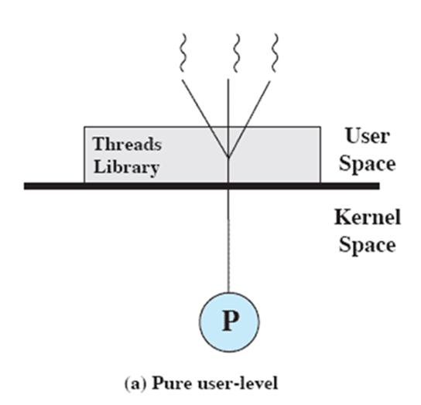
User-Level Threads (ULTs)
ULTs are created and managed by using thread library, which contains code and functions for creating and destroying threads, for passing messages between threads, scheduling thread execution, context switching etc.
The kernel is not aware of the existence of threads
Kernel is concerned about the process only
Department of Information Technology, VIIT, Pune-48
Notes:
USER-LEVEL THREADS
In a pure ULT facility, all of the work of thread management is done by the application and the kernel is not aware of the existence of threads. Figure 4.5a illustrates the pure ULT approach. Any application can be programmed to be multithreaded by using a threads library, which is a package of routines for ULT management. The threads library contains code for creating and destroying threads, for passing messages and data between threads, for scheduling thread execution, and for saving and restoring thread contexts.
By default, an application begins with a single thread and begins running in that thread. This application and its thread are allocated to a single process managed by the kernel. At any time that the application is running (the process is in the Running state), the application may spawn a new thread to run within the same process. Spawning is done by invoking the spawn utility in the threads library. Control is passed to that utility by a procedure call. The threads library creates a data structure for the new thread and then passes control to one of the threads within this process that is in the Ready state, using some scheduling algorithm. When control is passed to the library, the context of the current thread is saved, and when control is passed from the library to a thread, the context of that thread is restored. The context essentially consists of the contents of user registers, the program counter, and stack pointers.

Slide 94
Advantages of ULTs
Thread switching does not require kernel mode privileges (no mode switches)
Scheduling can be application specific
ULTs can run on any OS
Department of Information Technology, VIIT, Pune-48
Notes:
There are a number of advantages to the use of ULTs instead of KLTs, including the following:
1. Thread switching does not require kernel mode privileges because all of the
thread management data structures are within the user address space of a single process. Therefore, the process does not switch to the kernel mode to do thread management. This saves the overhead of two mode switches (user to kernel; kernel back to user).
2. Scheduling can be application specific. One application may benefit most
from a simple round-robin scheduling algorithm, while another might benefit from a priority-based scheduling algorithm. The scheduling algorithm can be tailored to the application without disturbing the underlying OS scheduler.
3. ULTs can run on any OS. No changes are required to the underlying kernel
to support ULTs. The threads library is a set of application-level functions shared by all applications.

Slide 95
Disadvantages of ULTs
In a typical OS, many system calls are blocking
As a result, when a ULT executes a system call, not only that thread is blocked, but all of the threads within the process are blocked because blocking one thread may cause the whole process to go in suspended state.
Department of Information Technology, VIIT, Pune-48
Notes:
There are two distinct disadvantages of ULTs compared to KLTs:
1. In a typical OS, many system calls are blocking. As a result, when a ULT
executes a system call, not only is that thread blocked, but also all of the threads within the process are blocked.
2. In a pure ULT strategy, a multithreaded application cannot take advantage
of multiprocessing. A kernel assigns one process to only one processor at a time. Therefore, only a single thread within a process can execute at a time. In effect, we have application-level multiprogramming within a single process. While this multiprogramming can result in a significant speedup of the application, there are applications that would benefit from the ability to execute portions of code simultaneously.

Slide 96
Overcoming ULT Disadvantages
Jacketing
converts a blocking system call into a non-blocking system call
Writing an application as multiple processes rather than multiple threads
Department of Information Technology, VIIT, Pune-48
Notes:
There are ways to work around these two problems. For example, both problems can be overcome by writing an application as multiple processes rather than multiple threads. But this approach eliminates the main advantage of threads: Each switch becomes a process switch rather than a thread switch, resulting in much
greater overhead. Another way to overcome the problem of blocking threads is to use a technique referred to as jacketing . The purpose of jacketing is to convert a blocking
system call into a non-blocking system call. For example, instead of directly calling a system I/O routine, a thread calls an application-level I/O jacket routine. Within this jacket routine is code that checks to determine if the I/O device is busy. If it is, the thread enters the Blocked state and passes control (through the threads library) to another thread. When this thread later is given control again, the jacket routine checks the I/O device again.

Slide 97
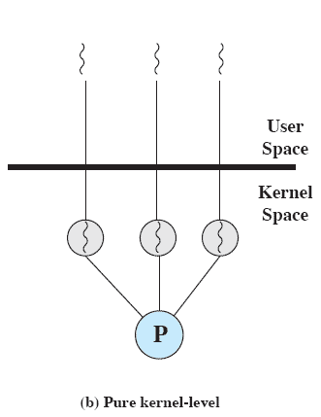
Kernel-Level Threads (KLTs)
Thread management is done by the kernel
No thread management is done by the application
Windows is an example of this approach
Department of Information Technology, VIIT, Pune-48
Notes:
KERNEL-LEVEL THREADS
In a pure KLT facility, all of the work of thread management is done by the kernel. There is no thread management code in the application level, simply an application programming interface (API) to the kernel thread facility. Windows is an example of this approach. Figure 4.5b depicts the pure KLT approach. The kernel maintains context
information for the process as a whole and for individual threads within the process.

Slide 98
Advantages of KLTs
If one thread in a process is blocked, the kernel can schedule another thread of the same process
Since Kernel can maintain full information about all threads, thread management and scheduling can be done efficiently.
Department of Information Technology, VIIT, Pune-48
Notes:
Scheduling by the kernel is done on a thread basis. This approach overcomes the two principal drawbacks of the ULT approach. First, the kernel can simultaneously schedule multiple threads from the same process on multiple processors. Second, if one thread in a process is blocked, the kernel can schedule another thread of the same process. Another advantage of the KLT approach is that kernel routines themselves can be multithreaded.

Slide 99
Disadvantage of KLTs
The transfer of control from one thread to another within the same process requires a mode switch to the kernel
Department of Information Technology, VIIT, Pune-48
Notes:
The principal disadvantage of the KLT approach compared to the ULT approach is that the transfer of control from one thread to another within the same process requires a mode switch to the kernel. To illustrate the differences, Table 4.1 shows the results of measurements taken on a uniprocessor VAX computer running a UNIX-like OS. The two benchmarks are as follows: Null Fork, the time to create, schedule, execute, and complete a process/thread that invokes the null procedure (i.e., the overhead of forking a process/thread); and Signal-Wait, the time for a process/thread to signal a waiting process/thread and then wait on a condition (i.e., the overhead of synchronizing two processes/threads together). We see that there is
an order of magnitude or more of difference between ULTs and KLTs and similarly between KLTs and processes.

Slide 100
ULT vs KLT
User Level Threads | Kernel Level Threads
ULTs are managed by user level libraries | KLTs are managed by OS
ULTs are typically fast | KLTs are typically slower
Context switching is faster | Context switching is slower
If one ULT is blocked, the entire process gets blocked | If one KLT is blocked, it has no effect on other threads and process.
Department of Information Technology, VIIT, Pune-48
Notes:
Thus, all of the threads of a process share the state and resources of that process. They reside in the same address space and have access to the same data. When one thread alters an item of data in memory, other threads see the results if and when they access that item. If one thread opens a file with read privileges, other threads in the same process can also read from that file.
The key benefits of threads derive from the performance implications:
1. It takes far less time to create a new thread in an existing process than to
create a brand-new process. Studies done by the Mach developers show that
thread creation is ten times faster than process creation in UNIX [TEVA87].
2. It takes less time to terminate a thread than a process.
3. It takes less time to switch between two threads within the same process than to switch between processes.
4. Threads enhance efficiency in communication between different executing programs. In most operating systems, communication between independent processes requires the intervention of the kernel to provide protection and the mechanisms needed for communication. However, because threads within the same process share memory and files, they can communicate with each other without invoking the kernel.
Thus, if there is an application or function that should be implemented as a set of related units of execution, it is far more efficient to do so as a collection of threads rather than a collection of separate processes.

Slide 101
Thread Scheduling
Round Robin Scheduling (RR),
Shortest Remaining Time First (SRTF),
Priority Scheduling (preemptive version)
Shortest job First ( Non Preemptive version)
Priority Scheduling(Non Preemtive version)
Department of Information Technology, VIIT, Pune-48
Notes:
Thus, all of the threads of a process share the state and resources of that process. They reside in the same address space and have access to the same data. When one thread alters an item of data in memory, other threads see the results if and when they access that item. If one thread opens a file with read privileges, other threads in the same process can also read from that file.
The key benefits of threads derive from the performance implications:
1. It takes far less time to create a new thread in an existing process than to
create a brand-new process. Studies done by the Mach developers show that
thread creation is ten times faster than process creation in UNIX [TEVA87].
2. It takes less time to terminate a thread than a process.
3. It takes less time to switch between two threads within the same process than to switch between processes.
4. Threads enhance efficiency in communication between different executing programs. In most operating systems, communication between independent processes requires the intervention of the kernel to provide protection and the mechanisms needed for communication. However, because threads within the same process share memory and files, they can communicate with each other without invoking the kernel.
Thus, if there is an application or function that should be implemented as a set of related units of execution, it is far more efficient to do so as a collection of threads rather than a collection of separate processes.

Slide 102
Thread programming Using Pthreads
In a Unix/Linux operating system, the C/C++ languages provide the POSIX thread(pthread) standard API(Application program Interface) for all thread related functions.
It allows us to create and manage the threads.
We must include the pthread.h header file at the beginning of the script to use all the functions of the pthreads library.
To execute the c file, we have to use the -pthread or -lpthread in the command line while compiling the file.
Department of Information Technology, VIIT, Pune-48
Notes:
Thus, all of the threads of a process share the state and resources of that process. They reside in the same address space and have access to the same data. When one thread alters an item of data in memory, other threads see the results if and when they access that item. If one thread opens a file with read privileges, other threads in the same process can also read from that file.
The key benefits of threads derive from the performance implications:
1. It takes far less time to create a new thread in an existing process than to
create a brand-new process. Studies done by the Mach developers show that
thread creation is ten times faster than process creation in UNIX [TEVA87].
2. It takes less time to terminate a thread than a process.
3. It takes less time to switch between two threads within the same process than to switch between processes.
4. Threads enhance efficiency in communication between different executing programs. In most operating systems, communication between independent processes requires the intervention of the kernel to provide protection and the mechanisms needed for communication. However, because threads within the same process share memory and files, they can communicate with each other without invoking the kernel.
Thus, if there is an application or function that should be implemented as a set of related units of execution, it is far more efficient to do so as a collection of threads rather than a collection of separate processes.

Slide 103
Thread programming Using Pthreads
#include <pthread.h>
pthread_create (thread, attr, start_routine, arg)
Parameter | Description
thread | unique identifier for the new thread returned by the subroutine.(addr of thread variable)
attr | attribute object that may be used to set thread attributes. You can specify a thread attributes object, or NULL for the default values.
start_routine | The C routine that the thread will execute once it is created.(name of the function, thread will execute)
arg | A single argument that may be passed to start_routine. It must be passed by reference as a pointer cast of type void. NULL may be used if no argument is to be passed.(data passed to the function)
Department of Information Technology, VIIT, Pune-48
Notes:
Thus, all of the threads of a process share the state and resources of that process. They reside in the same address space and have access to the same data. When one thread alters an item of data in memory, other threads see the results if and when they access that item. If one thread opens a file with read privileges, other threads in the same process can also read from that file.
The key benefits of threads derive from the performance implications:
1. It takes far less time to create a new thread in an existing process than to
create a brand-new process. Studies done by the Mach developers show that
thread creation is ten times faster than process creation in UNIX [TEVA87].
2. It takes less time to terminate a thread than a process.
3. It takes less time to switch between two threads within the same process than to switch between processes.
4. Threads enhance efficiency in communication between different executing programs. In most operating systems, communication between independent processes requires the intervention of the kernel to provide protection and the mechanisms needed for communication. However, because threads within the same process share memory and files, they can communicate with each other without invoking the kernel.
Thus, if there is an application or function that should be implemented as a set of related units of execution, it is far more efficient to do so as a collection of threads rather than a collection of separate processes.

Slide 104
Thread programming Using Pthreads
PThread_join
The pthread_join() function suspends the execution of the calling thread until the target thread terminates.
PThread_exit
The pthread_exit() function terminates the calling thread
Department of Information Technology, VIIT, Pune-48
Notes:
Thus, all of the threads of a process share the state and resources of that process. They reside in the same address space and have access to the same data. When one thread alters an item of data in memory, other threads see the results if and when they access that item. If one thread opens a file with read privileges, other threads in the same process can also read from that file.
The key benefits of threads derive from the performance implications:
1. It takes far less time to create a new thread in an existing process than to
create a brand-new process. Studies done by the Mach developers show that
thread creation is ten times faster than process creation in UNIX [TEVA87].
2. It takes less time to terminate a thread than a process.
3. It takes less time to switch between two threads within the same process than to switch between processes.
4. Threads enhance efficiency in communication between different executing programs. In most operating systems, communication between independent processes requires the intervention of the kernel to provide protection and the mechanisms needed for communication. However, because threads within the same process share memory and files, they can communicate with each other without invoking the kernel.
Thus, if there is an application or function that should be implemented as a set of related units of execution, it is far more efficient to do so as a collection of threads rather than a collection of separate processes.

